Slide 1
Using Smart View
UGA Budget Management System

Slide 2
Agenda
Introducing SmartView
Installing and Setting Up SmartView
Understanding the Database
Terminology and Concepts
UGA Dimensional Models
Logging Into Smart View
Creating an Ad Hoc Report
Symmetric vs Assymetric Reporting
Hiding and Docking the POV
Customizing the Quick Access Toolbar
Using What You Have Learned
Wrap-Up

Slide 3
Objectives
When you complete this course, you will know how to:
Setting up Smart View
Understand basic terminology and functionality
Log in to Smart View
Create an Ad-Hoc analysis
Use Smart View tools
Work with Smart View grids
*Instructions for installing Smart View are found in the Online Training Library

Slide 4
Introducing Smart View
Using Smart View for the UGA Budget Management System

Slide 5
Overview
Smart View is based on Microsoft Excel to provide an interface for Oracle Hyperion products
Users use Smart View to
View Data from the UGA Budget Management System
Import Data to the UGA Budget Management System
Model budget data
Report on budget data
Smart View works with Excel, Word, and PowerPoint

Slide 6
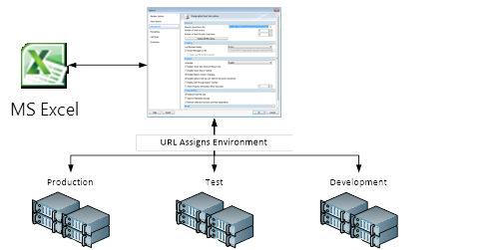
How Smart View Works
Connects via a URL that points Excel to different environments

Slide 7
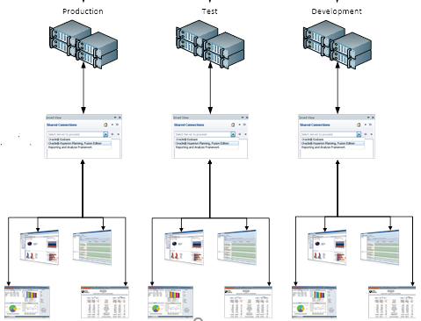
How Smart View Works
Uses a Provider Service to talk to an application
The user selects the application based on security

Slide 8
Installing and Setting Up Smart View
Using Smart View for the UGA Budget Management System

Slide 9
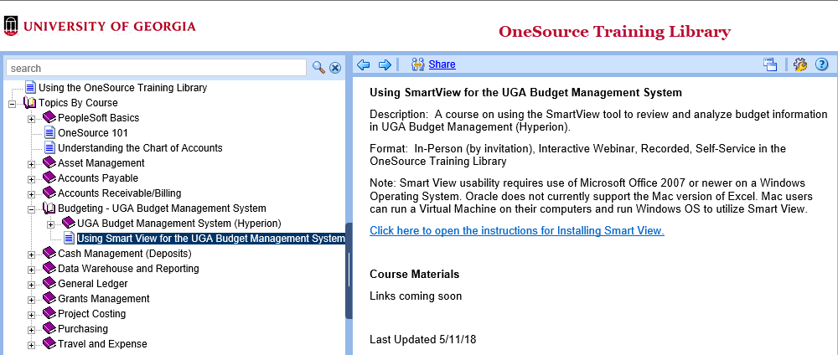
Installing Smart View
You can find the step-by-step instructions to install Smart View in the OneSource Training Library

Slide 10
Setting Up Smart View
This will add a new Smart View Ribbon when you open Excel
Click on the Options tab to set up Smart View

Slide 11
Smart View Shared Connections
Shared Connections are used to point Smart View to the correct environment URL.
This will point to the production environment. Enter the production URL on the Options > Advanced page.

Slide 12
Shared Connections
Choose the Advanced option in the Options dialog box to set up Shared Connections
Shared connections points Smart View to the production environment for retrieving data
The production environment URL is: https://budgets.onesource.uga.edu/workspace/SmartViewProviders

Slide 13
Understanding the Database
Using Smart View for the UGA Budget Management System

Slide 14
The Database Layer
Smart View is used primarily to retrieve data
It is helpful to understand the database structure to understand how data is retrieved
The UGA Budget Management System is based on a multidimensional database

Slide 15
Relational Database
A relational database is a collection with data stored in rows and columns
When new data is added a new row is added at the bottom
Each time you search for data, the system scans the table starting at the top
Expense Account | Department | Month | Amount
Travel Expenses | IT | Jan | 69155.85
Salaries | Marketing | Jan | 10914.1
Travel Expenses | Marketing | Jan | 37299.84
Salaries | IT | Jan | 96178.34
Office Supplies | Marketing | Jan | 24512.74
Salaries | Finance | Jan | 2787.84
Office Supplies | Finance | Jan | 48203.75
Salaries | Operations | Jan | 200000.71
Office Supplies | IT | Jan | 27965.21
Travel Expenses | IT | Feb | 73810.82
Salaries | Marketing | Feb | 58345.88
Salaries | Finance | Feb | 61193.23
Office Supplies | Finance | Feb | 64093.03
Office Supplies | IT | Feb | 97501.17
Salaries | IT | Feb | 40906.58
Travel Expenses | Marketing | Feb | 87459.36
Salaries | Operations | Feb | 200000.71
Computer Hardware | IT | Jan | 77161.24

Slide 16
Multidimensional Database
Data is pulled from the relational database in the UGA Financial Management System
Data is stored in the UGA Budget Management System in a multidimensional database
Intersections of data dimensions define data storage locations
What are my travel expenses in a specific department in a specific month
Month Dimension
Expense Account Dimension
Dimension Members
Data
Department Dimension

Slide 17
Terminology and Concepts
Using Smart View for the UGA Budget Management System

Slide 18
Dimensions
Dimensions are analogous to PeopleSoft chart fields
Data is located where the dimensions intersect, the database can easily find and retrieve data
Examples of Dimensions are:
Department
Account
Year
Program
Fund
Dimensions can be thought of as the axis of a report or a question you must answer in Smart View

Slide 19
Dimension Members
Dimension Members are analogous to PeopleSoft Chart Field Members
They are the discrete items that make up a dimension.
Examples of Dimension Members:
20000000 – Terry College of Business
1952000- CSCI Computer Science
FY18
10000 – RI-State Appropriations
A Dimension member can only belong to a single dimension
Dimension members can exist at various levels of a hierarchy

Slide 20
How Smart View Uses Dimensions and Dimension Members
Smart View is an Excel interface that allows you to arrange dimensions on various axes of reports
The axes of the report can be moved around to create the layout the user needs
Dimension members can be selected to determine exactly what data elements are reported
Dimension members can be easily changed to create an ad-hoc analysis that unfolds as the user learns more about the data

Slide 21
Rows and Columns
Year and Period are stacked on the columns
Entity and Account are stacked on the rows
Each grid must have at least one dimension on the rows and one dimension on the column
You can also stack multiple dimensions

Slide 22
Point of View (POV)
When you have a grid, the rows and columns represent the X and Y axis
The Point of View (POV) provides the Z axis that provide the pages of the report
The POV contains dimensions that don’t exist in columns and rows

Slide 23
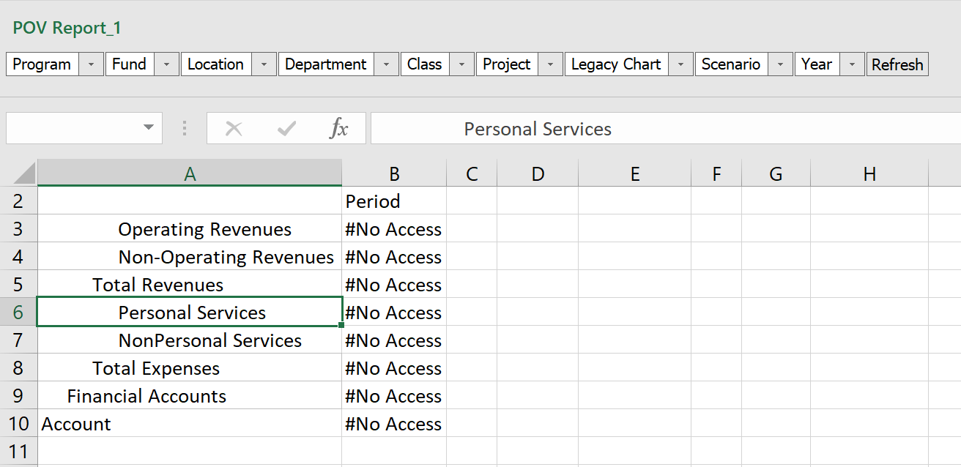
POV in a Ad Hoc Query
When used in a Ad Hoc query the POV box that can be “docked” at one edge of the grid or it can “float” in the main worksheet area of Excel.
Example of POV docked at top of screen

Slide 24
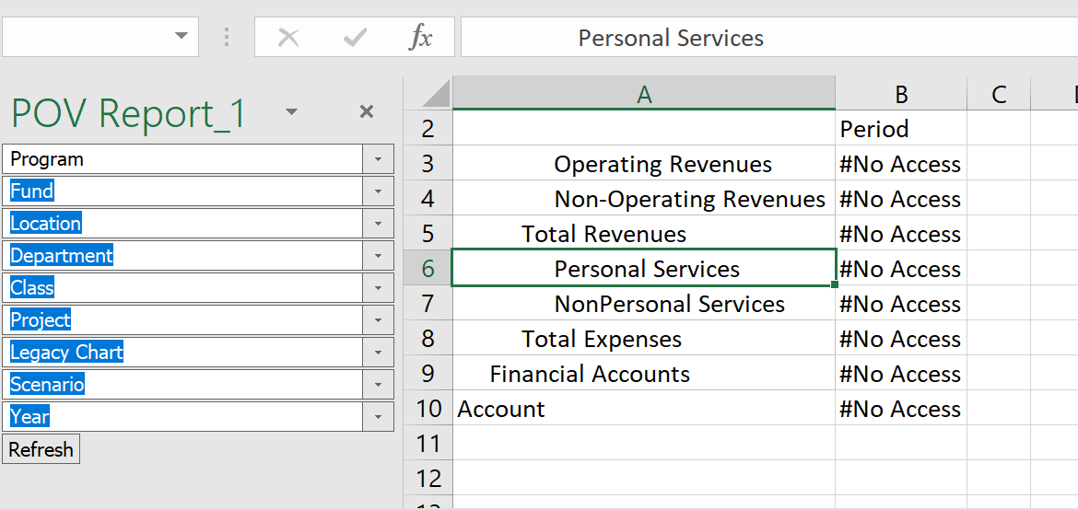
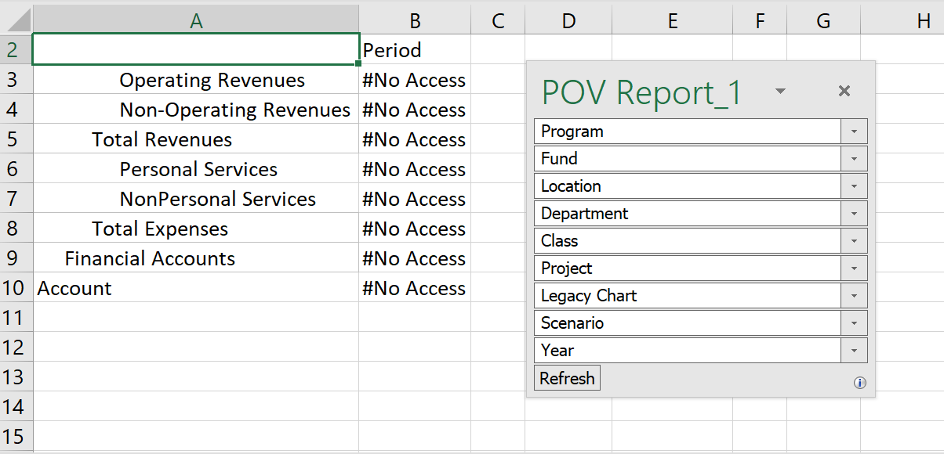
Examples of Docked POVs
Example of POV floating in content area.
Example of POV docked at right side of screen

Slide 25
Manual POV Line
Use the first row as the POV line
Only when using an Essbase connection
First row can act as the POV.

Slide 26
Hierarchies
Year Q1 Jan Feb Mar Q2 Apr May Jun Q3 Jul Aug Sep Q4 Oct Nov Dec
Hierarchies organize data into different levels
The top level is the default when the data is not broken down
Months add up to quarters, quarters add up to years

Slide 27
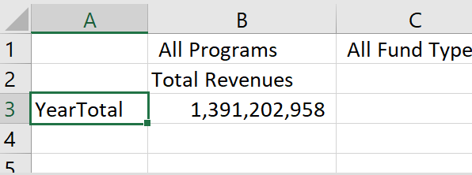
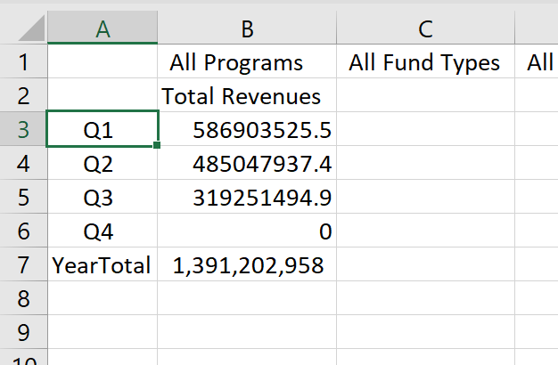
Drilling
Expanding the Hierarchy Options
Double-click
Ribbon options
Right Click
An example of drilling into the “YearTotal” value to see the quarterly detail underneath.

Slide 28
A Warning About Drilling
Drilling is a powerful tool for investigating data and find the details that make up data. However as you drill in it is possible to retrieve thousands or even millions of rows of data
Retrieving too much data into Excel can cause performance slowdowns
If you accidentally retrieve too much data restarting Excel or your laptop will usually fix the performance issue.

Slide 29
Hierarchy Terminology
“Genealogical” or “family tree” language used to describe the positions of dimension members
Parent/Child
Ancestor/Descendants
Siblings
Generation
Levels
Alternate hierarchies
If a dimension contains more than one hierarchy, the first value is referred to as the main or base hierarchy
Any others are called alternate hierarchies
If a member appears in a hierarchy more than once, subsequent appearances are called shared members

Slide 30
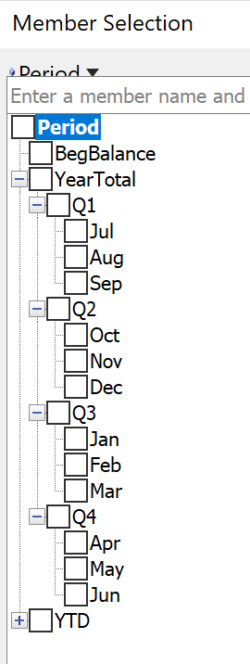
Parent/Child
“Jul”, “Aug” and “Sep” are all children of “Q1”.
Likewise, the parent of “Q1”, “Q2”, “Q3” and “Q4” is “YearTotal”.

Slide 31
Ancestor/Descendents
Extending across more than one level in the hierarchy
Ancestor: All members above a particular member (includes the parent)
Descendent: all members beneath a particular member (includes the child or children)
The Descendants of “YearTotal” include all the quarters and months.
The Ancestors of “Oct” are “Q2” and “YearTotal”

Slide 32
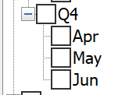
Siblings
Share the same parent
The siblings of “Apr” are “May” and “Jun”

Slide 33
Generation
A number that represents the distance to the top of the hierarchy.
The generation number starts with “1”
A particular member only has one generational number within a hierarchy
Generation 1
Generation 2
Generation 3

Slide 34
Level
A number that represents the distance up from the bottom of the hierarchy.
The generation number starts with “0”
A particular member only has one generational number within a hierarchy
Level 2
Level 1
Level 0

Slide 35
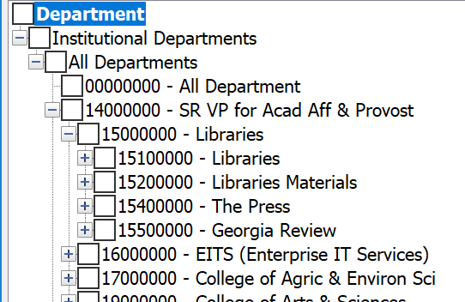
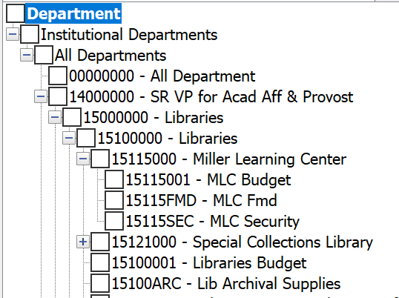
Levels in an Unbalanced Hierarchy
In this example, “Libraries” is made up of multiple branches of the family tree, “Libraries”, “Libraries Materials”, “The Press”, etc.
If we start at member “15115001” and walk up the hierarchy using the “Libraries” branch, we would count and say that “All Departments” is at level 5

Slide 36
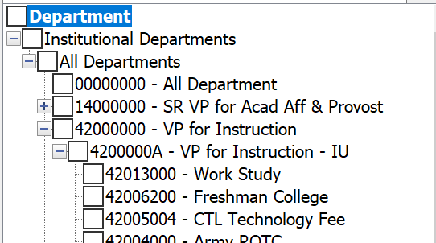
Levels in an Unbalanced Hierarchy
However, if we start at member “42013000” and walk up the hierarchy using the “VP for Instruction” branch, we would count and say that “All Departments” is at level 3.
If you are at Level 0, you are always at the bottom of the hierarchy (also called the “leaf” level)

Slide 37
UGA Dimensional Models
Using Smart View for the UGA Budget Management System

Slide 38
Cubes Used at UGA
Report Essbase Application
Report Database (11 dimensions)
Account
Period
Program
Fund
Location
Department
Class
Project
Legacy Chart
Scenario
Year
UGABUD Planning Application
Personal Database (12 dimensions)
Account
Period
Program
Fund
Location
Department
Position
Class
Project
Version
Scenario
Year

Slide 39
Logging In to Smart View
Using Smart View for the UGA Budget Management System

Slide 40
Log In to Smart View
Go to the Smart View ribbon in Excel.
Click on the Panel icon.
The Smart View Panel Opens

Slide 41
Log In to Smart View
Click the Shared Connections Option
A dropdown asks you to select a provider.

Slide 42
Log In to Smart View
Enter your MyID credentials to connect to the UGA Budget Management System
Click the Connect button.

Slide 43
Log In to Smart View
Smart View can identify with different types of applications. You will need to select the database you want. This is the Provider.
Select the appropriate Provider.

Slide 44
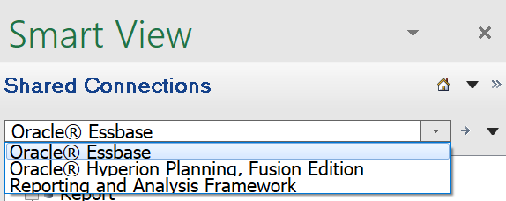
Log In to Smart View
“Oracle Essbase” is the Essbase Provider.
Report Application
“Oracle Hyperion Planning, Fusion Edition” is the Planning Provider
Personal Application
Amendment Application
Budgeting Application (future)

Slide 45
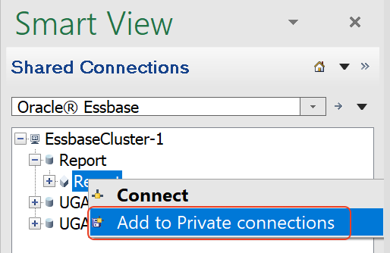
Private Connections
You can create a library of connections that you use frequently.
As you drill down, you can right-click on the database and select Add to Private Connections.

Slide 46
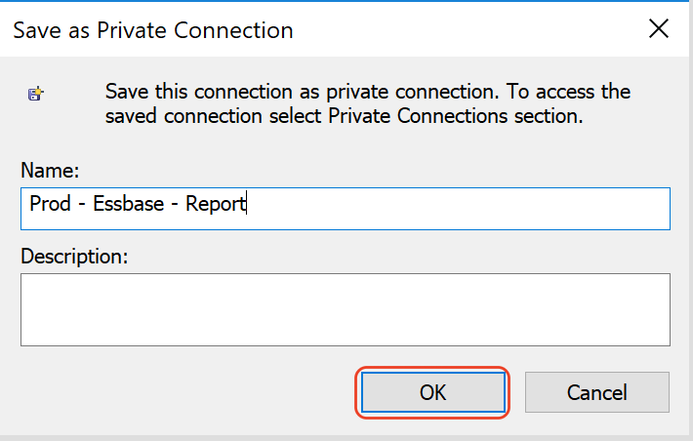
Naming your Private Connection
A good practice to naming your connection is to provide three pieces of information: the environment name, the provider type, and the database or application name.

Slide 47
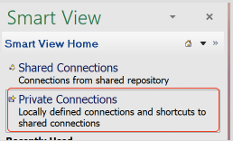
Selecting a Private Connection
After you have saved your favorites you can select Private Connections when opening Smart View.
You will then be asked to select a provider

Slide 48
Creating an Ad Hoc Query
Using Smart View for the UGA Budget Management System

Slide 49
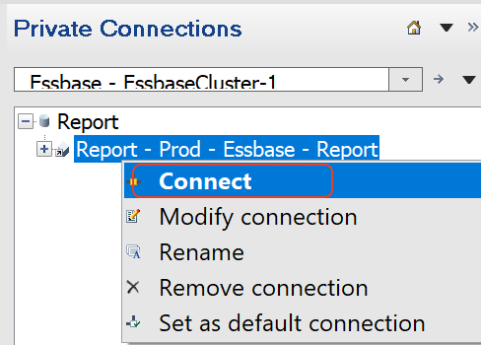
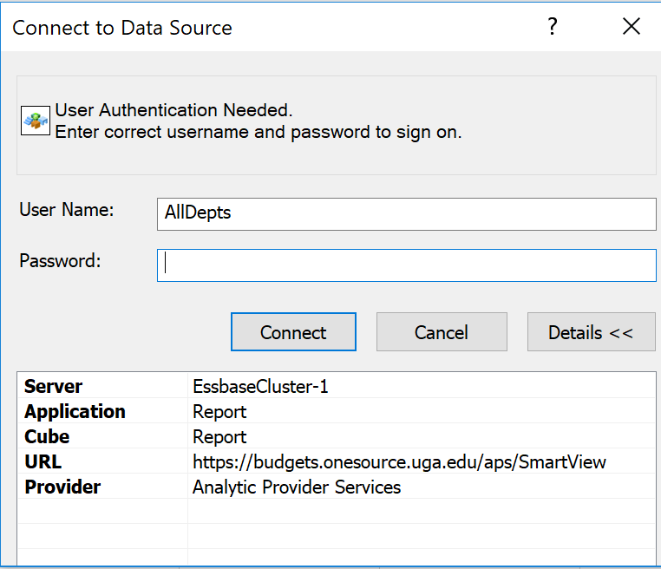
Starting your Ad Hoc Query
Click on the database you want for your query. If you haven’t established a connection you will need to login.

Slide 50
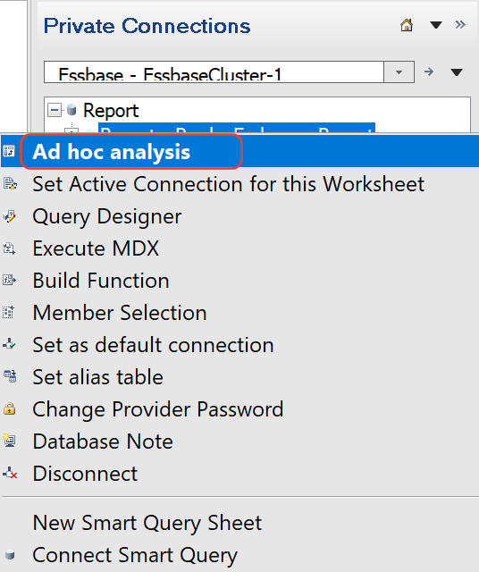
Starting your Ad Hoc Query
Right click on the database name or use the menu in the bottom right corner on the Smart View panel to select Ad hoc analysis

Slide 51
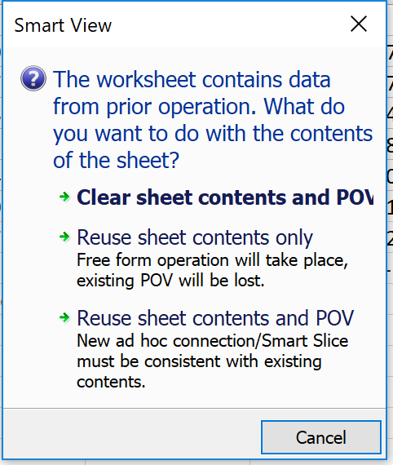
Starting an Ad Hoc Query
If you select an application your menu will prompt you to select a database.
After you select the database, the ad hoc query grid will open. If there is data from a prior session, you will be asked if you want to clear the contents.

Slide 52
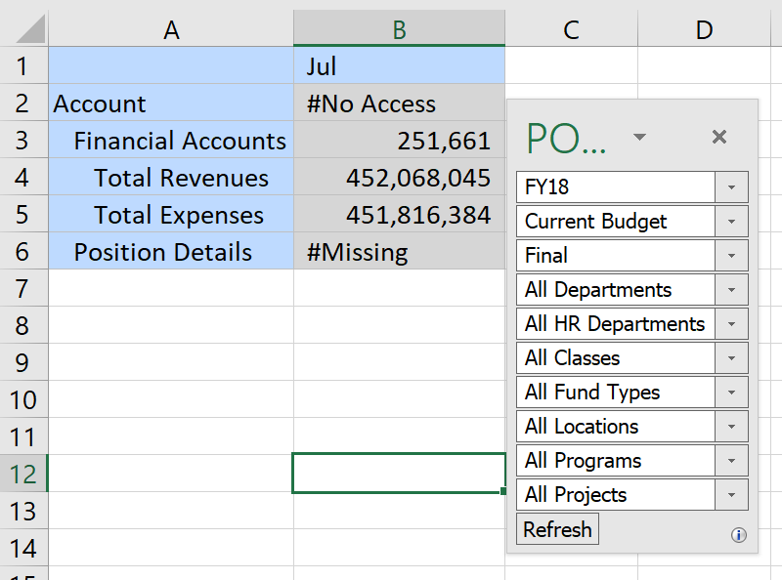
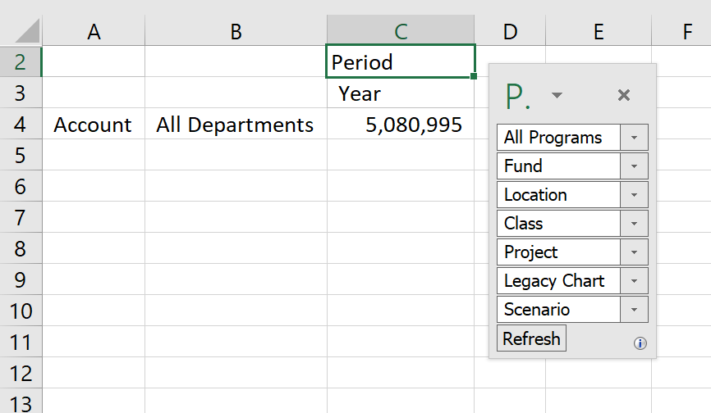
Starting an Ad Hoc Query
The grid that opens may be different on which provider you select.
Planning Provider Grid
Essbase Provider Grid

Slide 53
Context Sensitive Ribbons
Different ribbons are displayed for different types of Ad Hoc Queries. Shown below is the Smart View ribbon.
After connecting a menu specific to the active connection with all necessary commands for a data source displayed on one ribbon.
Some commands may appear on more than one ribbon.

Slide 54
Other Ribbon Examples
Planning Ribbon
Planning Ad Hoc Ribbon
Essbase Ribbon (Ad Hoc)

Slide 55
Ad Hoc Analysis Tools
There are several tools that are helpful in ad hoc analysis. Let’s explore the following.
Refresh
Submit Data
Member Selector
Zoom In
Next Level
All Levels
Bottom Level Same Level
Sibling Level
Same Generation Level
Formula
Retaining Selected Member
Ancestor Position
Pivot
Planning Pivot
Essbase Pivot
Dragging and Dropping
Keep Only
Remove Only
Change Alias
Cascade

Slide 56
Pivot Tool
The Pivot Tool allows you to switch the axis on which a dimension is reported.
The default behavior of the pivot tool depends on the type of connection you are using.

Slide 57
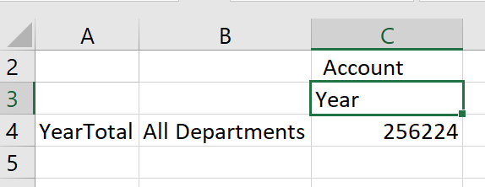
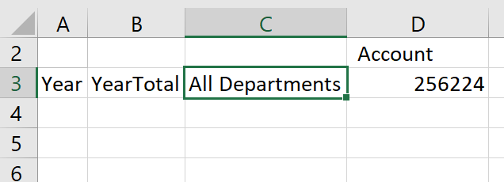
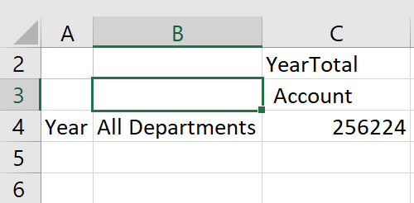
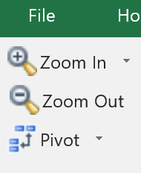
Pivot Tool with Planning Connection
The Pivot tool in a planning connection where you have selected a dimension on the column will pivot to the rows. If you are on a row, it will pivot to the column

Slide 58
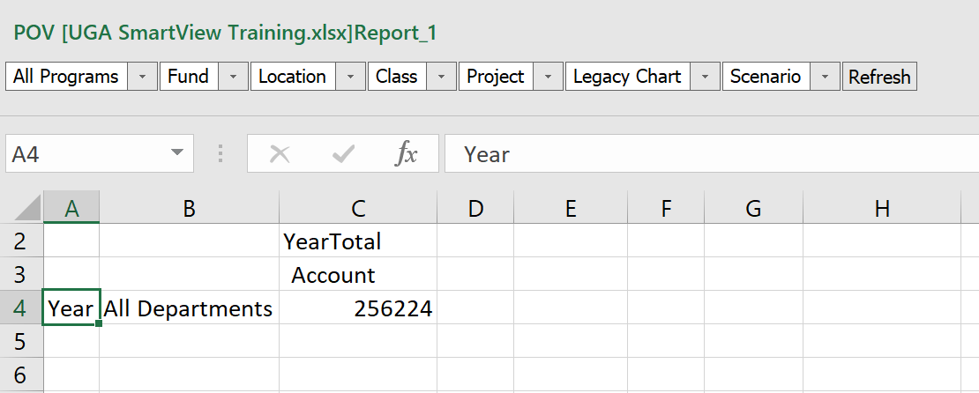
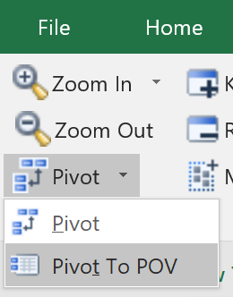
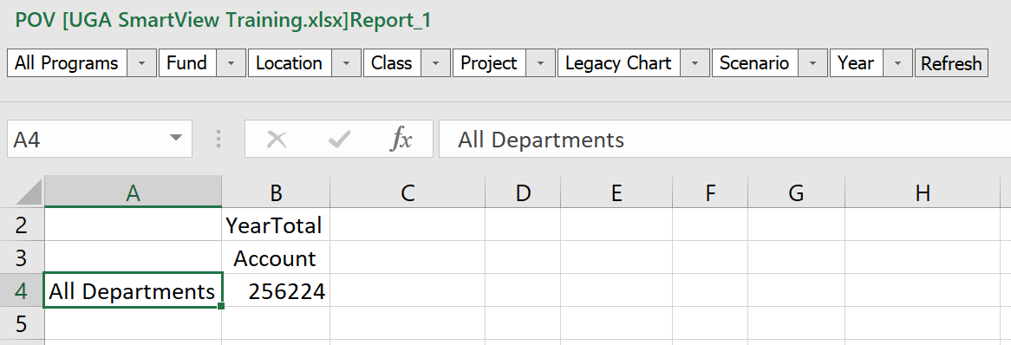
Planning Pivot to POV
You can use the pivot to POV dropdown to send a row or column dimension to the POV

Slide 59
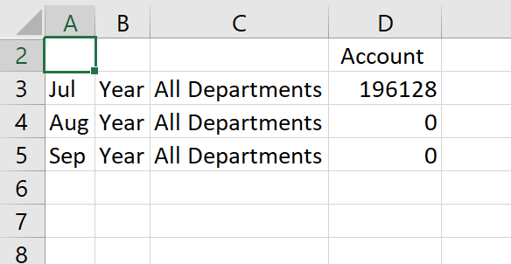
Pivot Tool with Essbase Connection
The Pivot tool in an Essbase connection where you have selected a dimension on the column will pivot to the rows.

Slide 60
Pivot Tool with Essbase Connection
If you area using the top row of the grid as the POV and Pivot, it will go to the rows.

Slide 61
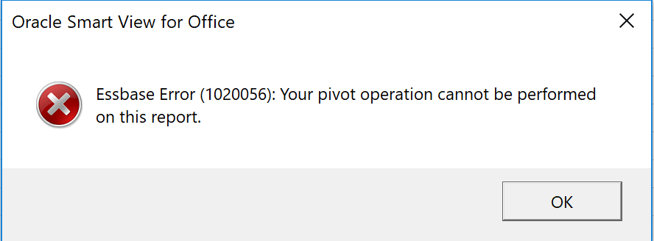
Pivot Tool with Essbase Connection
You must always have at least one dimension on the row and column. If you attempt to pivot with the last dimension on the row or column, you will get the error below:

Slide 62
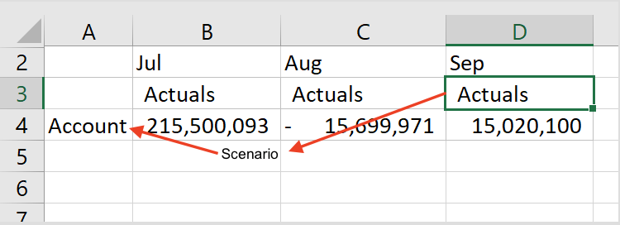
Dragging and Dropping
You can also change the axis a dimension is on by dragging and dropping.
For dimensions that are in the rows or columns, right click and hold down to drag and drop.
When released the grid will redraw, pivoting the dropped dimension.

Slide 63
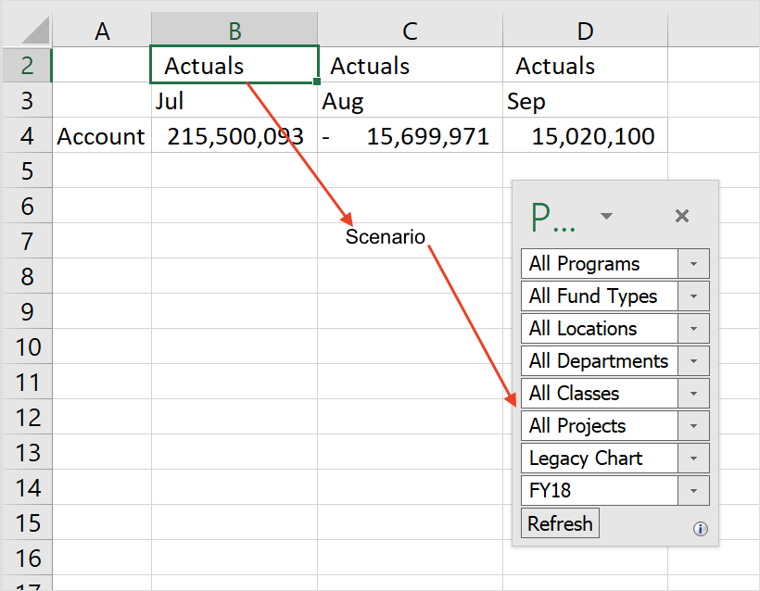
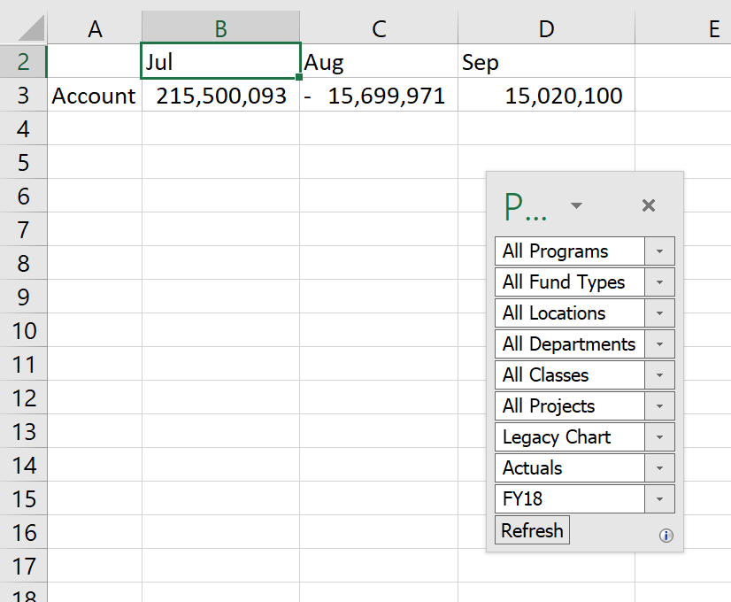
Drag and Drop in Essbase
You can drag from the grid to the POV.

Slide 64
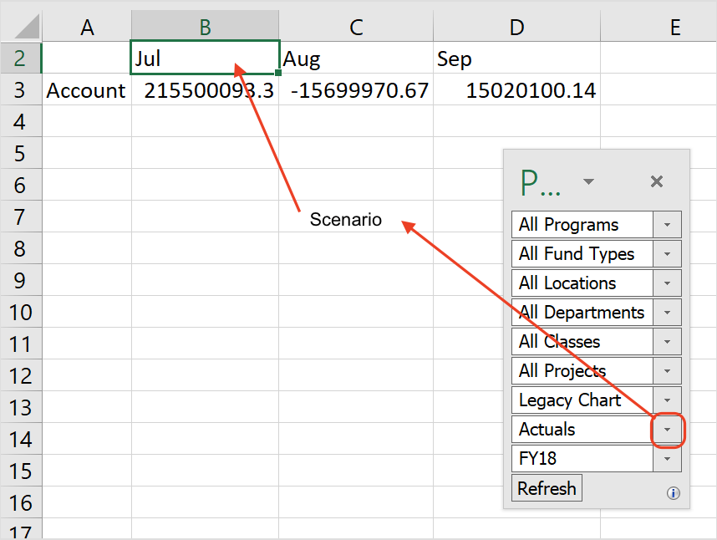
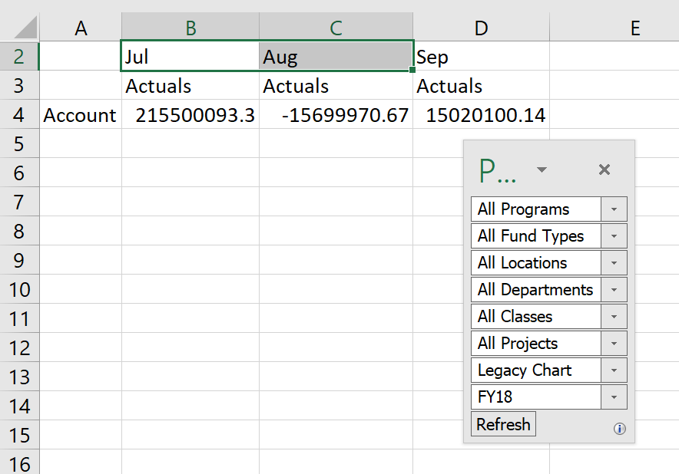
Drag and Drop from POV to Grid
For both Essbase and Planning connections, you can right or left click on the dropdown button next to the dimension name in the POV to initiate the drag from the POV to a grid.

Slide 65
Refresh
The refresh button lets you take data from the grid you have defined and pull it into Smart View.
If you don’t have a grid open, it will open a new grid.
If you have a grid open, data will be imported into that and will overwrite any unsaved data you might have.

Slide 66
Submit Data
Submit Data uploads the changes you make to Smart View into the underlying database.
You must have write access to the database to do this.
Generally, it is better to use planning applications instead of the database to limit this.

Slide 67
Member Selector
The member selection tool allows you to navigate dimension members using a GUI interface. Selections can be placed on rows and columns

Slide 68
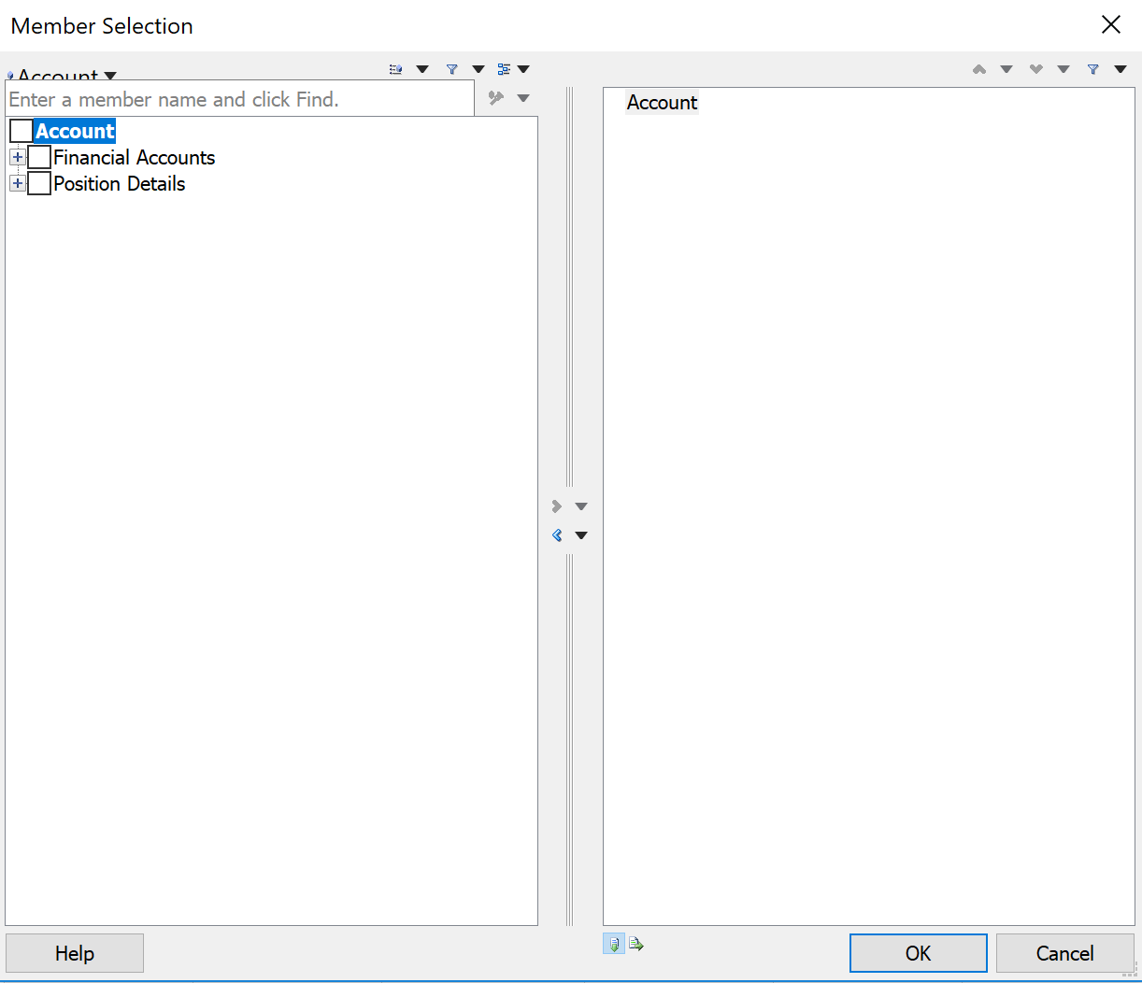
Member Selector
The left half contains all the values available for selection.
Use the checkboxes and arrows to move the values to the right half of the screen.
The Member Selector is split into two main areas.
The right half contains the selected values.

Slide 69
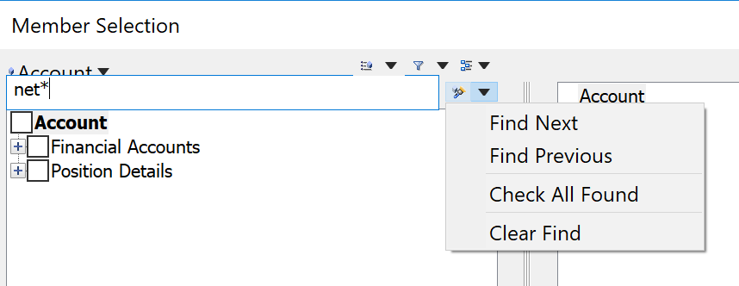
Member Selector
Use the search box at the top of the screen to perform text-based searches of the data. Wildcards are star (*) and question marks (?). The drop-down box to the right of the field controls how the search works.
Insert on rows
The direction keys at the bottom of the box control whether values are inserted into columns or rows.
Insert on columns

Slide 70
Options Setup
Use the Options button on the Smart View ribbon to control how data is displayed

Slide 71
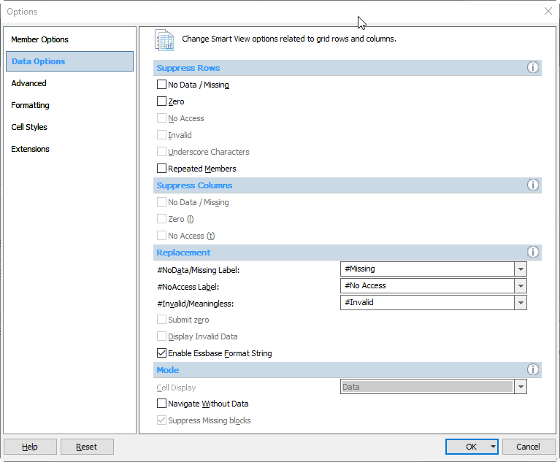
Data Options Set Up
Choose the Data Options option in the Options dialog box.
Suppression
Smart View has the ability to hide rows and columns of data that are missing. When it does this we say the row or column is “suppressed”. This is controlled from the smart view “Data Options” dialog box.

Slide 72
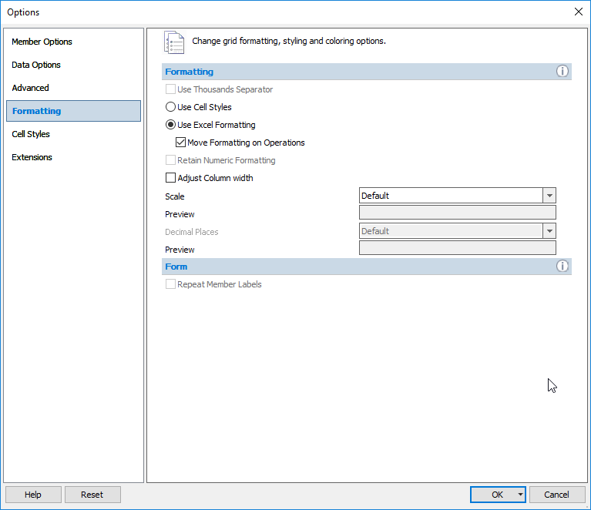
Data Options Set Up
Choose the Formatting option in the Options dialog box.
Excel Formatting
The easiest way to format data though is to use the normal excel formatting options. To use excel formatting make sure you have the “Use Excel Formatting” and “Move Formatting on Operations” option selected.

Slide 73
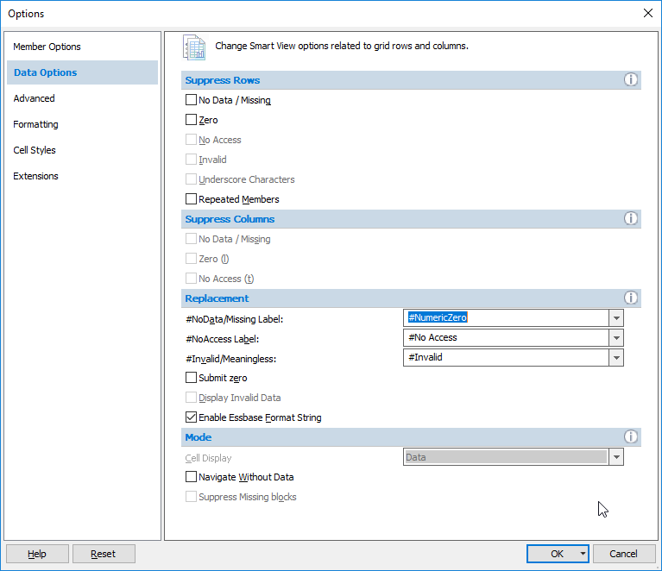
Data Options Set Up
Choose the Data Options tab in the Options dialog box.
Numeric Zero
Another very useful option is the ability to define missing data as “Numeric Zero”.

Slide 74
Zoom In
The various Zoom in tools give control over drilling into and out of data.
`

Slide 75
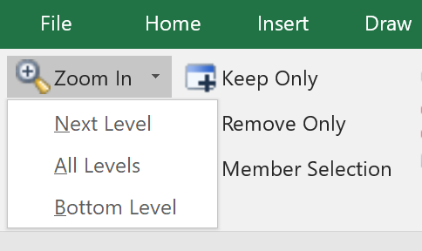
Zoom In Options
There are several options when zooming into data.
1 level down
All levels
The bottom level of a hierarchy

Slide 76
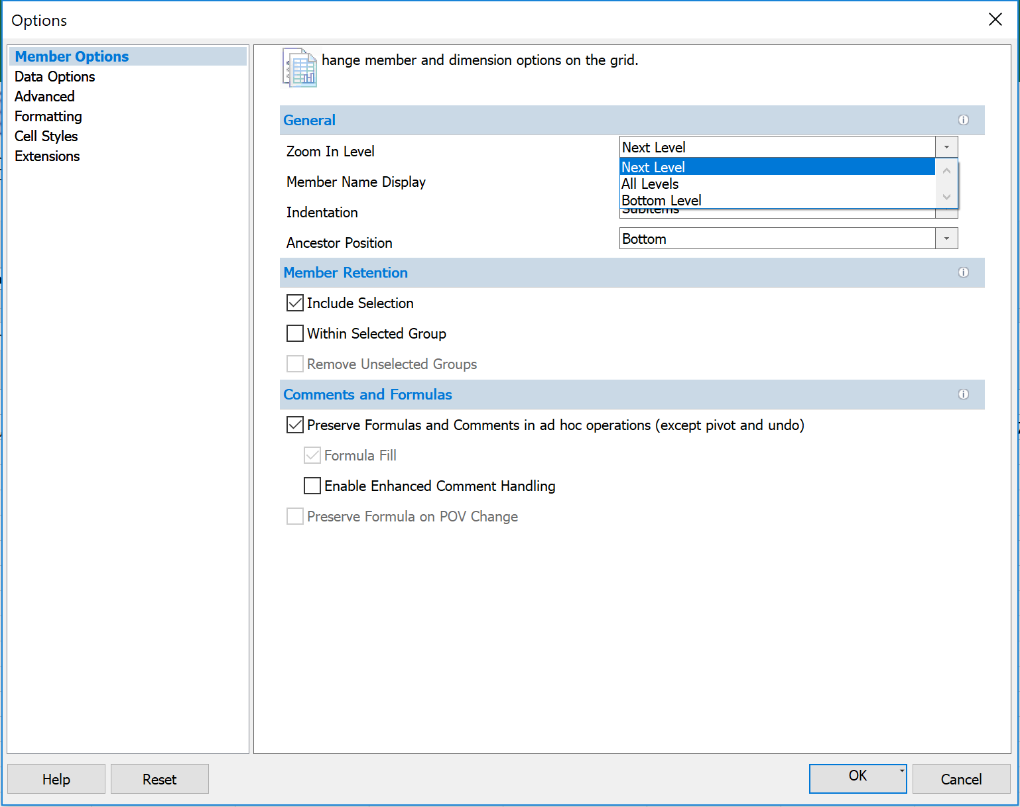
Zoom Behavior
The default behavior is set up on Member Options page of the Smart View options dialog. Select the Zoom In Level option used most often as the default.

Slide 77
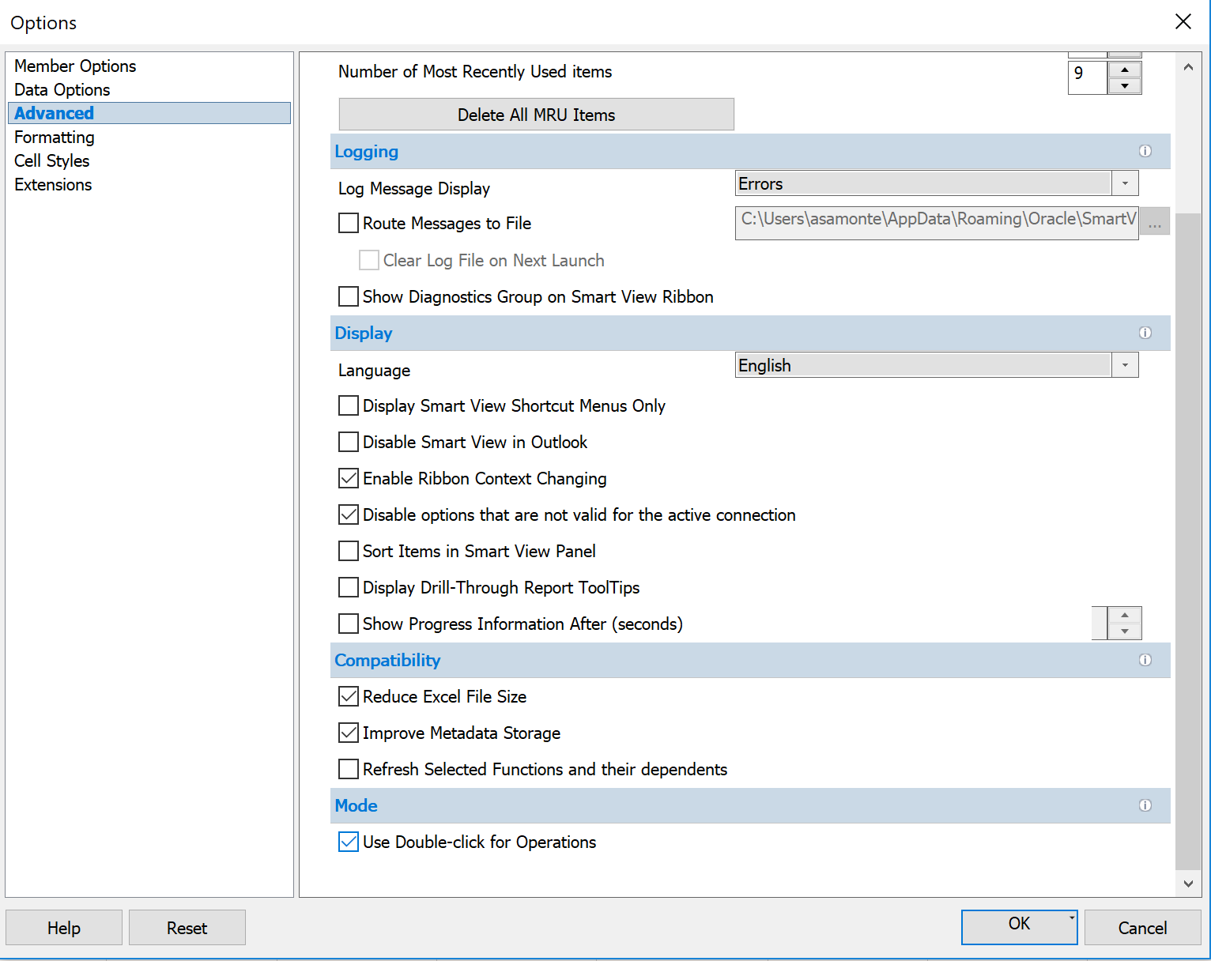
Zoom in Option
If you selected “Use Double-click for Operations” on the Advanced options page, the Zoom In Level action you chose on the Member Options page will be performed when you double-click.

Slide 78
Zoom In Option
No matter what you choose as the default, you can change the type of zoom using the zoom in drop-down list on the right side of the button in the ribbon.
Zooming in is based on a starting point in the hierarchy that is determined by the dimension member currently selected in the grid.

Slide 79
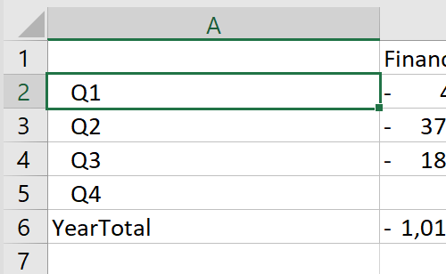
Next Level Zoom
Zooming to the next level opens up the next level down in the hierarchy.

Slide 80
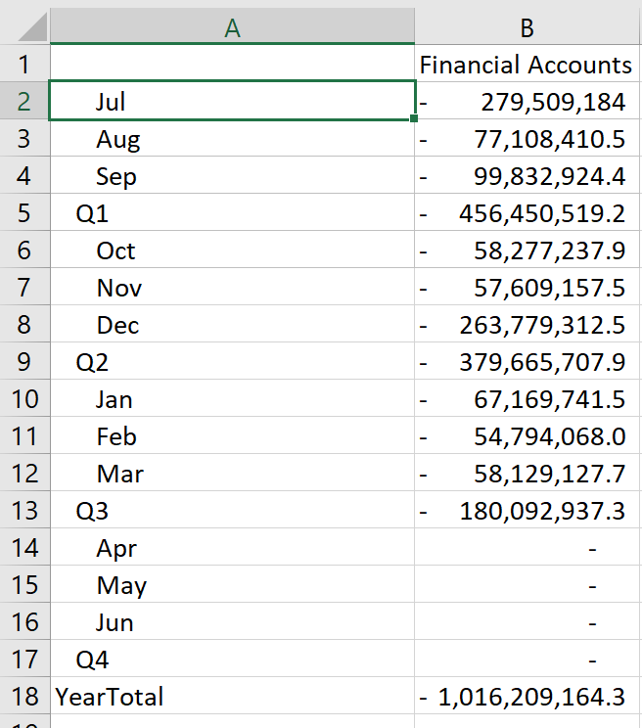
All Levels Zoom
Zooming to all levels will open up all values beneath the starting point.

Slide 81
Bottom Level Zoom
Zooming to the bottom level will zoom to the leaf (below zero) level beneath the starting point.

Slide 82
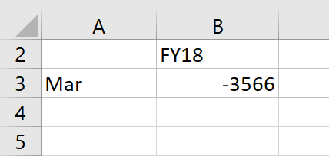
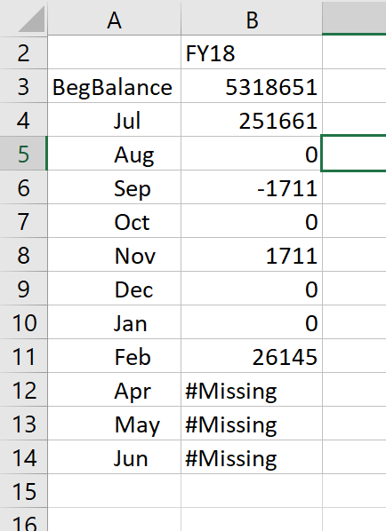
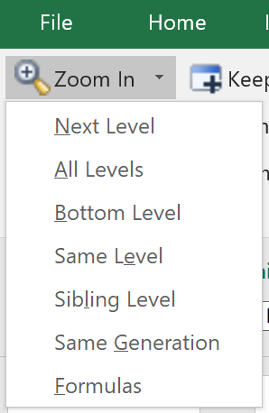
Same Level
Same level zooming will zoom to all values in the same level value. This option is only available in Essbase connections.

Slide 83
Sibling Level
Sibling level zooming will zoom to all values that have the same parent as the source value. This option is only available in Essbase connections.

Slide 84
Retaining Selected Member Options
On the Member Options page, the “Include Selection” options control whether the initial starting point is retained in the zoom or discarded.

Slide 85
Zoom Retaining Selected Member
With member retention turned on, the Year Total stays in the query.

Slide 86
Zoom Without Selected Member
With member retention turned off, the Year Total is not included in the query.

Slide 87
Ancestor Position Options
When zooming into data, you can control how members in the hierarchy are sorted.
Ancestors at the top and descendants at the bottom (how database nerds like things)
Descendants at the top and ancestors at the bottom (how accounting nerds like things)
*Only for Planning Connections
Set up on the Member Options page

Slide 88
Ancestor Position Examples
Ancestor Position = Bottom
Ancestor Position = Top

Slide 89
Zoom Out
Zoom Out is the opposite of Zooming In.
It moves from the selected member one step up the hierarchy.

Slide 90
Keep and Remove
The Keep and Remove tools allow you to easily subset the data in your grid.

Slide 91
Keep Only
It is possible to select more than one dimension member (use control or shift keys) when using the Keep or Remove option.
It is keeping the selected members, not the rows or columns. In this example, July & Aug were selected on rows 6 & 7. All occurrences were saved, not just the ones on rows 6 & 7.

Slide 92
Remove Only
The Remove Only option is similar. It removes values from the grid instead of keeping them.
It is keeping the selected members, not the rows or columns. In this example, July & Aug were selected on rows 6 & 7. All occurrences were saved, not just the ones on rows 6 & 7.

Slide 93
Change Alias
The Change Alias button allows you to control the alias table that is displayed in a grid (or if no alias table is used)

Slide 94
Change Alias
Tip: If you are using a private connection, you can change the default alias table associated with the connection by right clicking on the connection name.

Slide 95
Cascade
Cascade allows you to take any dimension values selected in the POV and expand them out across multiple Excel tabs.

Slide 96
Performing a Cascade Operation
When performing a cascade operation, it is possible to have the new tabs be in the same workbook, a new workbook or different workbook.
If you select Different Workbooks, it will open a different workbook for each permutation instead of different tabs.

Slide 97
Using Member Selection
When you open the cascade dialog box, you’ll be prompted to choose multiple values for any dimension that exists in the POV. Use the Member Selection tool to select the values you want.

Slide 98
Cascade Results
Smart View will create a new tab (or workbook) for each selected value.

Slide 99
Undo/Redo
The native Undo and Redo functionality in Excel does not work with Smart View.
There are separate undo and redo functions on the SmartView ribbon.
These can undo and redo many tasks.
These cannot undo a data submission in a data form.
The Excel undo and redo buttons will not work with Smart View actions

Slide 100
Select Members by Typing
If you know the name of a member, you can simply type it in the correct location in the grid. Then when you press refresh, the grid will update appropriately.
It doesn’t matter if you type in the member name or the alias name, Smart View will detect the correct member and update the grid appropriately.

Slide 101
Selecting Members by Typing
You can add new members into an adjacent cell to expand the grid. Be sure that all dimensions for that axis are fully accounted for.
Typing “FY17” into D2 will result in an error, because the period dimension is also on the columns.

Slide 102
Selecting Members by Typing
In the example below, the number of columns is expanded because all dimensions are accounted for.

Slide 103
Deleting Rows and Columns
Use the normal Excel Delete Row or Delete Column functions to re-draw a grid and refresh. This can be an easy way to remove data.
After deleting the row in Excel and refreshing, the grid will continue to function normally.

Slide 104
Symmetric vs Asymmetric Reporting
Using Smart View for the UGA Budget Management System

Slide 105
Symmetric vs Asymmetric Reporting
The default behavior for Smart View is for data to expand symmetrically.
This means that when there is more than one dimension on an axis, any expansion of one dimension will happen for all permutations of the other dimension members on that axis.

Slide 106
Symmetric Example
If you zoom in one level on Q1, the grid grows symmetrically.

Slide 107
Asymmetric Example
If you only want to see a select combination of dimensions on the rows, you can manually type in values and delete rows to just retain the values you want.
Not every member of the first dimension would be associated with every member of the second dimension.

Slide 108
Hiding and Docking the POV
Using Smart View for the UGA Budget Management System

Slide 109
The Floating POV Box
Use the POV button to display the floating POV box
You have the ability to either hide or dock the POV box at any time in a Planning or Essbase query.
The POV button will hide the POV box.

Slide 110
Essbase with Floating POV
Essbase with floating POV
Essbase with 1st Row as POV
You can toggle between having a separate POV box and using the first row of the grid.
You can only use the first row as the POV on an Essbase connection.

Slide 111
Docking the POV
Grab the top part of the floating POV with your mouse and drag it to one of the edges of the screen.
You can dock on the top, bottom, left or right side of the screen.

Slide 112
Undocking the Toolbar
Undocking is the reverse. Grab the top of the docked POV and drag it to the center part of the grid

Slide 113
Customizing the Quick Access Toolbar
Using Smart View for the UGA Budget Management System

Slide 114
Customizing the Quick Access Toolbar
Using standard Excel functionality you can customize the Quick Access Toolbar at the top of the Excel screen.
To start, open the ribbon you want to customize.
Right-click and select Customize Quick Access Toolbar from the menu that appears.

Slide 115
Customizing the Quick Access Toolbar
In the Choose commands from field, select the ribbon or All Commands option to find the shortcut you are interested in.
Select the shortcut to add.
Click the Add button in the middle.
When the shortcut is added to the right side, click on OK.

Slide 116
Questions
Department Specific Questions?
Call or email the OneSource Service Desk
onesource@uga.edu
706-542-0202
Notes:
Take this opportunity to allow questions from participants before transitioning into the next section
Encourage people to send department-specific or situation-specific questions to OneSource for additional research

Slide 117
Using What You Have Learned
Using Smart View for the UGA Budget Management System
Notes:
Let’s wrap up what we’ve learned today.

Slide 118
Duplicate This Report in Smart View
Have a look at the Budgetary Detail Report and recreate the layout using Smart View

Slide 119
Wrap Up
Using Smart View for the UGA Budget Management System
Notes:
Let’s wrap up what we’ve learned today.

Slide 120
Summary
During this training, you have learned to:
Configure Smart View to create ad hoc reports
Understand basic terminology and functionality
Log in to Smart View
Create an Ad-Hoc analysis
Use Smart View tools

Slide 121
Resources
OneSource Budgeting Resources page
OneSource website Resources page
OneSource Training Library: training.onesource.uga.edu
Notes:
The slide includes links to the OneSource Training Library and the Resources page of the OneSource Website

