Slide 1
Manager Self Service for System Managers
One USG Connect
Notes:
Give a nice welcome to the attendees.
Introduce yourself. Let them know your name, your home department, how long you’ve worked at UGA, and other general information about who you are.
Let them know that you are a volunteer and that you are still learning the system yourself.
Introduce the class, the Manager Self Service for System Managers course, and be sure to use the word training often in the first few slides.

Slide 2
Objectives
By the end of this course, you will:
Understand the System Manager role and responsibilities in OneUSG Connect
Learn how to complete MSS transactions in OneUSG Connect
Understand the basic concepts of Commitment Accounting in OneUSG Connect
Locate combination codes for your department and understand how they are used to define position funding
Understand how positions are funded and how to request changes to funding
Understand how to initiate retro distributions
Notes:
In this class we will cover:
The responsibilities assigned to the system manager role
These are the HR and payroll transactions that record an employee’s work history and transactions that affect pay.
How to perform the tasks assigned to the system manager
You will use the navigator to go to the fluid pages which only have a few fields to complete for each transaction.
How to update position funding and to understand how Commitment Accounting works in OneUSG Connect
It is the responsibility of each department to oversee the funding of their unit’s positions. This is done using the Commitment Accounting pages which are a little more complicated than recording job changes.
We will take a break about halfway through today’s training, and we will give you opportunities to ask questions.
For Webinars: You can always ask questions during a webinar by submitting them in the Questions box.
For In Person classes: You can ask questions at any time during class.

Slide 3
Manager Self Service Courses
OneUSG Connect Overview
Time & Absence Approver
MSS System Managers
MSS for
Supervisors
Approving MSS Transactions
*Managers/Approvers should choose the session(s) that best applies to them, based on their assigned role(s).
Notes:
All of the MSS courses are based on security roles. Check with your Project Coordinator for more information about the security roles.
Anyone with a reports-to role can manage employees through Manager Self Service.
Reports To Supervisors may also serve as Time & Absence Approvers. However, Reports-To Supervisors do not need to take the T&A Approvers course in addition to the MSS for Supervisors course.

Slide 4
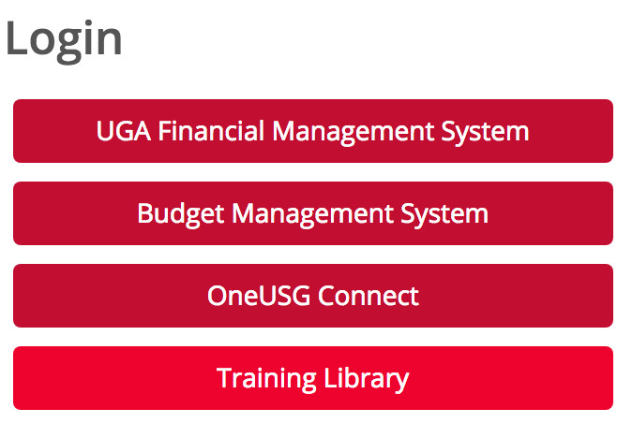
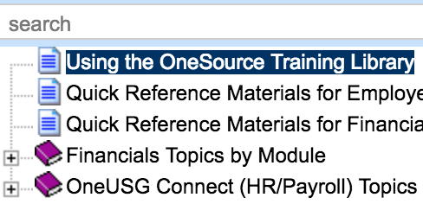
How to Get to the OneSource Training Library
Go to https://training.onesource.uga.edu OR
Go to https://onesource.uga.edu | On the main homepage, click on Training Library under Login. | Click on the + icon to expand the menu to search a topic. OR Type keywords in the search box to search a topic.
Notes:
You can get to the OneSource Training Library by using the direct link: https://training.onesource.uga.edu OR
Start from the https://onesource.uga.edu website and click on the Training Library button under the Login prompt.

Slide 5
Introducing Manager Self Service (MSS)
Manager Self Service for System Managers
Notes:
Let’s look at the responsibilities for the system manager.

Slide 6
System Managers
System Managers are individuals who have been assigned the BOR_UGA_SYSTEM_MANAGER role in OneUSG Connect.
System Managers are able to use the OneUSG Connect System to:
Initiate a termination or retirement
Request an ad hoc salary or supplemental pay request
Request to adjust employee leave balances
Change position funding
Notes:
System managers have been assigned a specific role within OneUSG Connect. This role gives them permissions to perform the actions shown.
System managers initiate Manager Self Service personnel actions.
Note: Time and absence transactions are assigned to unit managers.
All transactions except change funding are requests that go through approval workflow before being committed to the system by a central practitioner.

Slide 7
Past to Future Systems
employee.uga.edu
OneUSG Connect
Employee Self Service
Kronos
eLeave
WebDFS
OneUSG Connect + UGAJobs
IMS Mainframe
OneUSG Connect
QMF
Notes:
The various legacy systems are found on the left side of the screen. The activities performed in those systems have been rerouted to OneUSG Connect or UGAJobs.
See the System Changes resource page on the OneSource website (address shown on slide) for more information on the system changes.

Slide 8
WebDFS Actions & OneUSG Connect
UGAJobs | OneUSG Connect ESS or MSS | USG Process
New Employee Transfer Promotion Replacement Position Appointment to New Position Change % Time Employed Change in Pay Type Change in Title HR Reclass: Title Only HR Reclass: Job class and title only | Department-Initiated Actions Continuation Existing Position Revise distribution of salary Termination Rate Range Change County Money Compression/Market Faculty Compression/Market Staff Employee-Initiated Actions: Change name | Leave Without Pay Prior Year Back Pay (retro pay process) Summer Back Pay (USG summer pay process)
I did this in WebDFS . Where will I perform these actions now?
Please refer to the Personnel-Related Transactions Matrix for more information.
Notes:
The left box shows how the reason codes in Manager Self Service are translated back to UGAJobs.
The middle box contains the tasks performed in OneUSG Connect by managers and employees
The third box shows processes that will be handled by USG.
[Pause and allow the attendees to read the screen.]
[Inform attendees they can refer back to the Personnel-Related Transactions Matrix (located in the OneSource Training Library) for more information.]
Only read the following if someone asks about the difference between rate range and rate change:
Rate range is different from rate change. Rate range is only utilized by a couple of departments (maybe even one, Rec Sports). This allows them to use a range of rates to pay their students based on the task for which they are clocking in. An example: A lifeguard might make more working the front desk than they would for the lifeguard job.

Slide 9
Manager Self Service homepage
Notes:
The system normally opens to the Employee Self Service page. Navigation at the top center of the page takes you to the Manager Self Service homepage. On that page you will find a tile called My Team which has information on the employees who report to you directly.
Employees who display on the Team Tile are your direct reports-to.

Slide 10
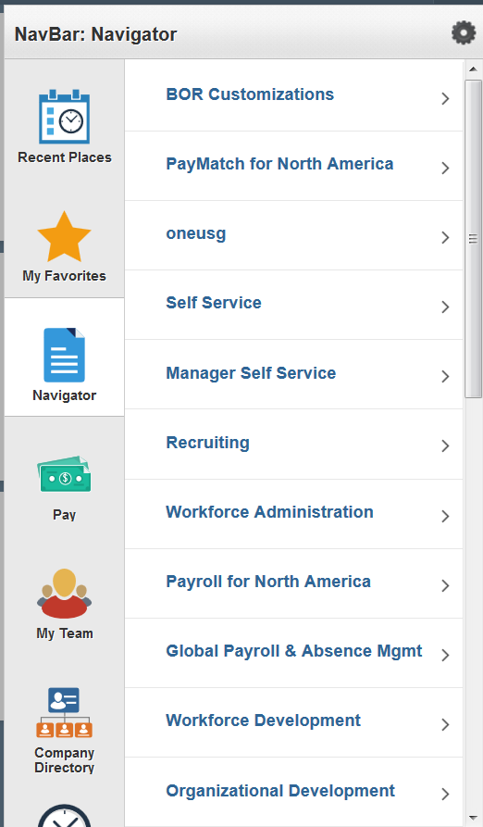
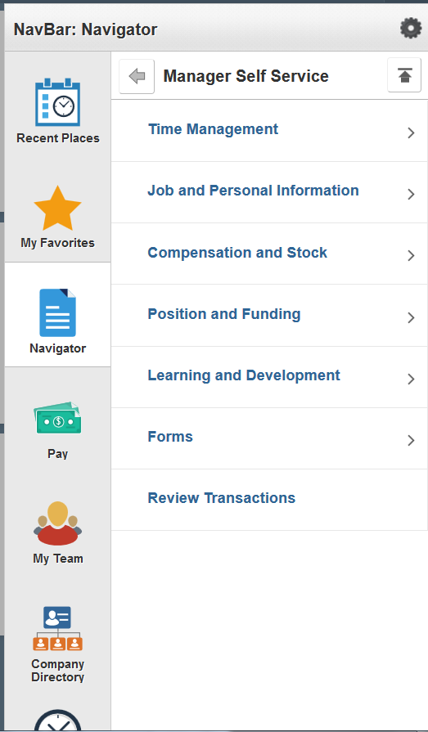
Manager Self Service Navigation
Notes:
For a manager to initiate transactions to the employees assigned to you, you will need to use the navigator menu.
The navigator is found using the compass icon on the upper right of the OneUSG Connect homepages.
The items found on the menus appear based on the roles which you have been assigned. Your menu may look different based on your security assignment.
From the navigator menu, click on Manager Self Service. This will open another menu with the categories of transactions you can perform.

Slide 11
Benefits of OneUSG Connect for System Managers
Streamlines business processes and increases efficiency
Creates consistency across departments and units
Every unit is following the same process, which means employees can get better support from Central offices
Reliable tracking and monitoring of transaction status
Digitizes process to save money, time, and paper
Notes:
Business processes have been reviewed and streamlined to ensure that everyone submits transactions in the same way.
Workflow has been simplified and is traceable by the initiators, approvers, and managers that have access to the transaction.
An example: No more T&A Approvals beyond the Reports-To and T&A Approver
Electronic forms reduce paper and ensure speedier access to view and approve transactions.

Slide 12
Introducing MSS Transactions
Manager Self Service for System Managers
Notes:
Now we’ll take a look at the transactions that system managers can perform.

Slide 13
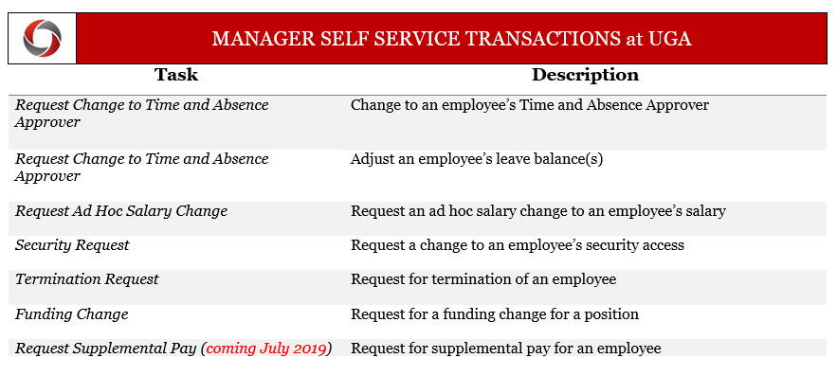
Manager Self-Service Transactions at UGA
Notes:
Manager self-service transactions are actions that managers request in OneUSG Connect. They are only requests until the final approval, at which point, the data is entered into the system.
This slide shows the transactions that managers can initiate. These are separate from the actions a manager might do for direct reports.
While managers might do these things for their direct reports, they will likely also do them for people who don’t report to them. It is also possible for managers to not have any direct reports and still have access to initiate these transactions.
The transactions can be initiated by individuals in departments; however, approvers of the transactions should be the Chief Business Officers or Chief Human Resources Officer for the college or unit, since this type of approval carries signature authority.
Most of these will follow the same workflow with two exceptions:
Security Requests and Termination Requests will need to be initiated at the college or unit level by a CBO or HR Liaison. This is because they have a slightly different workflow routing. They will go straight to the central approvers instead of passing through a departmental approver first.
The Request Change to Time and Absence Approver is new and will be used to communicate approver changes to the central offices.
The Leave Balance Adjustment will be used rarely, as most changes will take place in absence management transactions or on the time card.
Ad hoc salary changes are broad and are used to communicate salary adjustments of all types.
Documents required to be submitted can be attached to the online transactions.

Slide 14
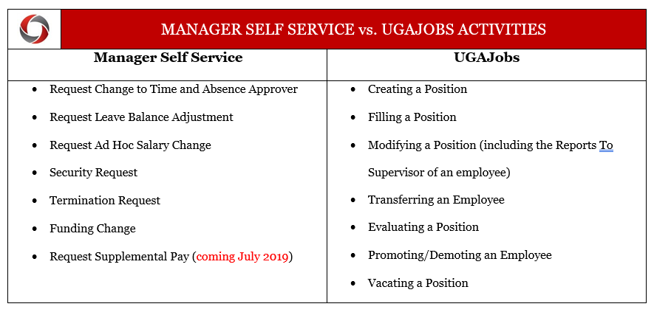
MSS vs UGAJobs
Notes:
These are the activities performed in Manager Self Service and in UGAJobs.
With the move to OneUSG Connect, there are very few changes being made to UGAJobs.

Slide 15
Enrolling/Updating a Time Reporter
All employees are automatically enrolled in Time & Labor in OneUSG Connect when they are hired. An employee’s Time Reporter enrollment is based on their pay group and determines how the employee enters time, as well as whether the employee earns overtime or comp time.
Once an employee is hired and an employee record is created in OneUSG Connect, it is the responsibility of the hiring unit/distributed unit to make sure the employee is enrolled correctly as a Time Reporter.
The following slide displays steps for System Managers to enroll or update a Time Reporter (employee) in OneUSG Connect.
*For additional information refer to the Enroll/Update Time Reporter Standard Operating Procedure (SOP).
Notes:
All employees are automatically enrolled in Time & Labor in OneUSG Connect upon being hired.
The hiring unit/distributed unit must make sure the employee is enrolled correctly as a Time Reporter.
System Managers can follow the steps on the next slide to make sure the employee is enrolled correctly as a Time Reporter.
The link at the bottom of this slide also provides you with additional information about the SOP for enrolling/updating a Time Reporter.

Slide 16
Enrolling/Updating a Time Reporter
System Managers (Initiators) should follow these steps to enroll or update a Time Reporter (employee) in OneUSG Connect:
Send an email to OneUSG Support via oneusgsupport@uga.edu with the subject line: Time Reporter Update
Include the following information in the email:
Employee ID
Employee’s full name
What needs to change:
Time Entry Method (Kaba Clock, Web Clock, Pay from Schedule, Manual)
Overtime or Comp Time
Auto-Meal Deduction (30 minute, 60 minute, or none)
14 Hour Special Accrual (Y or N)
The email generates a ServiceNow ticket that will be routed to the Central Office.
The Central Office updates the employee’s Time Reporter setup in OneUSG Connect and resolves the ServiceNow ticket.
The Department HR Practitioner will receive a notification from ServiceNow that the Time Reporter setup has been updated in OneUSG Connect, and the time reporting rules will be applied to the employee’s time entries moving forward, effective the first day of the pay period.
Notes:
These are the steps for System Managers to follow to enroll or update a Time Reporter.

Slide 17
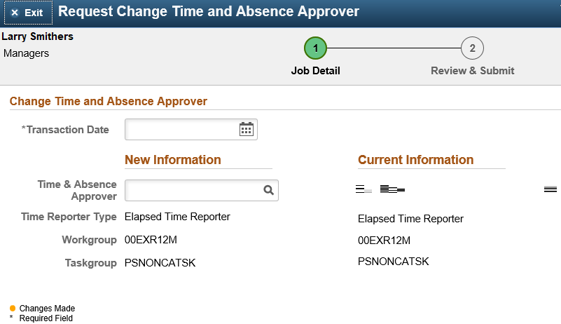
Request Change to Time and Absence Approver
You can assign any UGA employee to be the Time & Absence Approver for another UGA employee
If you are changing Time & Absence Approvers in bulk (i.e. for 50+ employees at a time, such as for employees that change departments of terminate employment), contact oneusgsupport@uga.edu.
Notes:
This is a new transaction for managers. This is what you need to make requests for changing a time and absence approver for a small group of employees (<50).
If you need to make changes for a large group (>50) contact oneusgsupport@uga.edu for help assigning in bulk. They will help you to create a spreadsheet that can be updated.

Slide 18
Requesting a Change to an Employee’s Time & Absence Approver
This Photo by Unknown Author is licensed under CC BY-SA
Notes:
Demonstration by Instructor
Walkthrough OneSource Training Library Topic: Requesting a Change to an Employee’s Time & Absence Approver

Slide 19
Requesting Leave Changes
Absences and extended leave events should be submitted in OneUSG Connect
Employees started submitting leave in OneUSG Connect beginning:
Bi-weekly: 12/16/2018
Academic and Monthly: 1/1/2019
Unapproved time and leave requests will be uncompensated until approvals are completed. Once approved, it will be paid out on a later check.
Notes:
Employees are now requesting absences and extended leaves in OneUSG.
It's important to note that unapproved time and leave requests will be uncompensated until approvals are completed. Once approved, it will be paid out on a later check.

Slide 20
Leave Balances
If you’re a monthly or academic employee, leave balance will be available for use the first of the next month
For biweekly-paid staff, it will be available at the beginning of the pay period that holds the 1st of the month
You actually earn it on the 15th of the month
Note: You cannot have a negative leave balance
The request will go uncompensated, even if you are a salaried employee, per USG policy
Notes:
Leave balances are available at different times for bi-weekly employees than for monthly or academic employees.
Monthly and academic employees will have leave balances available for use at the beginning of the next month
Bi-weekly paid staff will have leave balances available in the pay period that includes the 1st of the month (leave is earned on the 15th of the month)
USG policy is that negative leave balances are not permitted. Requests will not be compensated, even for salaried employees.

Slide 21
Cascading Rules
Leave is deducted from your balances using a set of “cascading rules”
A set of rules put into place per USG policy on which type of leave to deduct from first
When cascading rules are applied, the leave balances will be deducted accordingly. However, the timesheet/paystub will reflect the type of leave that was originally requested.
Notes:
(Read points on slide.)
We’ll look at a chart on the next slide.

Slide 22
Cascading Rules for Leave
# | Leave Type | Cascade | Accrual | Limits** | Carryover**
1 | Comp Time* | N/A | N | 240 hours | N – FY Payout
2 | Deferred Holiday* | N/A | N | 40 hours | N
3 | Sick Leave | 3-1-2-4 | 8 hours/month | N | Y
4 | Vacation | 1-2-4 | 10, 12, or 14 hours/ month depending on years of service | 360 hours | Y
5 | Sick-Bereavement | 3-1-2-4 | N | N | N
6 | FMLA Intermittent | 3-1-2-4 | N | 480 hours | Rolling
7 | Jury | N/A | N | N | N
8 | Education Support | N/A | 8 hours/year | 8 hours | N
9 | Blood Donation | N/A | N | 2 hours per 8 max | N
10 | Blood Platelets | N/A | N | 4 hours per 16 max | N
11 | Voting | N/A | N | 2 hours | N
* Not applicable for monthly employees ** See applicable policy
Notes:
Leave is deducted from your balances using a set of USG “cascading rules” that determine what type of leave is used first.
The system is set up to follow USG policy.
(Discuss how to read this chart, starting with Sick or Annual leave).
Note that monthly employees are not eligible for comp time or deferred holidays.
FYI: It is important to note that employees should NOT select Intermittent FMLA unless they have entered an Extended Leave Request and are on an approved Intermittent FMLA event. Once an employee has received approval they can then use the Intermittent FMLA type as a regular absence event.

Slide 23
Cascading Rules Example
Example: An employee requests Vacation (annual) leave but has a comp time balance. The system will deduct the comp time balance before deducting the Vacation leave balance.
Comp time does not cascade. Best practice is to select Vacation Leave when you want to take comp time, which will automatically deduct from your comp time first
If you select comp time and you do not have enough to cover your request, it will not cascade to deduct from vacation leave
Notes:
(Read example.)

Slide 24
C
Extended Absences
Employees can request an extended leave event in OneUSG Connect.
Extended absence requests are made for sick leave greater than 5 consecutive days. These are the eight (8) types of extended absences (Absence Types).
Bone marrow donation
Education/Professional/Development Leave
FMLA
Medical non-FMLA
Military
Organ Donation
Personal
Workers Compensation
Employees who wish to request Extended Leave are encouraged to first discuss their leave needs with their department HR practitioner. *Please refer to the Standard Operating Procedure (SOP) on Extended Absences for more information.
Notes:
(Read the information on Extended Absences.)
Additional information on the Extended Absences process can be found in the SOP.

Slide 25
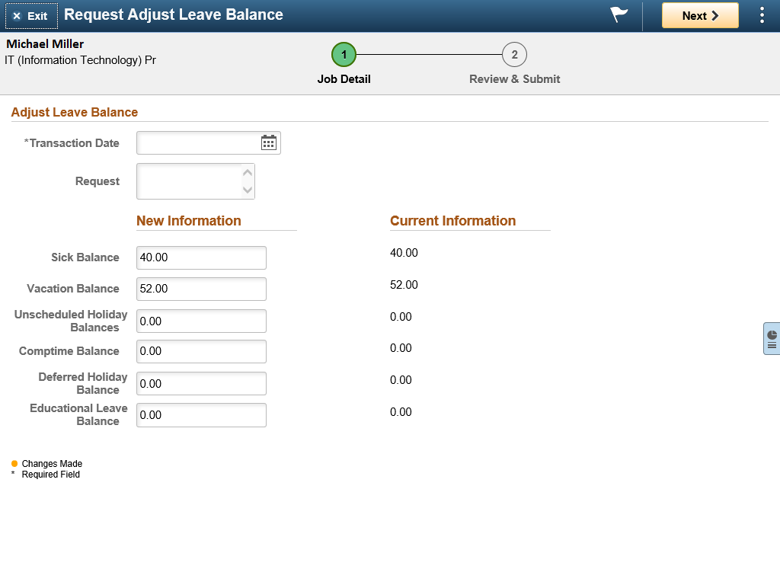
Request Leave Balance Adjustment
In OneUSG Connect, it should happen minimally because you can make corrections without entering a request to adjust the balance.
Employees, supervisors, and time & absence approvers can edit leave submitted and it will pick up on the next on-cycle for correction
Notes:
In OneUSG Connect, leave balances will be adjusted through time cards and absence requests.
In the system, employees, their supervisors, or time & absence approvers will be able to edit submitted leave so that it can be picked up on the next payroll to correct the balance.

Slide 26
Requesting a Leave Balance Adjustment
This Photo by Unknown Author is licensed under CC BY-SA
Notes:
Demonstration by Instructor – Use Try It! mode
Walkthrough OneSource Training Library Topic: Requesting a Leave Balance Adjustment

Slide 27
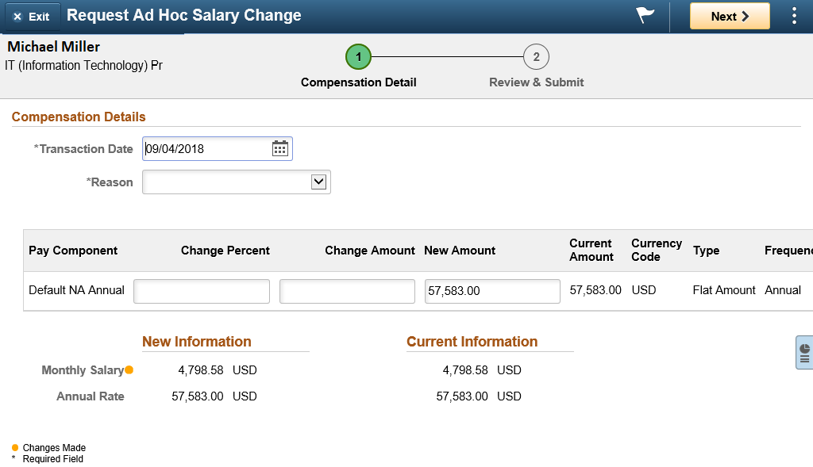
Request Ad Hoc Salary Change
Ad hoc salary change is used to submit salary adjustments to central offices after intra-departmental authorizations have already been obtained.
Departments should still follow previous procedures, such as obtaining a request for salary adjustment (RSA), and attaching documentation via the attachment functionality within the OneUSG Connect Manager Self-Service form.
Notes:
The Request Ad Hoc Salary Change task replaced the current personnel to change salary.
This should be submitted after all required intra-department authorizations have been obtained.
Continue to use the current forms just as they are now, such as the RSA. Attach the forms as documentation

Slide 28
Requesting an Ad Hoc Salary Change
This Photo by Unknown Author is licensed under CC BY-SA
Notes:
Demonstration by Instructor
Walkthrough OneSource Training Library Topic: Requesting an Ad Hoc Salary Change

Slide 29
Request Supplemental Pay
Supplemental pay is what UGA currently refers to as Supplements or Extra Compensation payments
The same forms used previously have been updated for OneUSG Connect fields and will need to be completed, approved, and sent to hrweb@uga.edu
Until July 2019, Payroll will enter supplemental pay into OneUSG Connect based on information from supplemental pay forms
After July 2019, department managers enter certain supplemental pay information via Manager Self Service in OneUSG Connect
Training will be available closer to that time.
Notes:
Payroll will enter the supplemental pay until July 2019
You will still be responsible for filling out and submitting the forms to payroll
Forms that are sent directly to Payroll after final approval:​
Request for Extra Compensation (Special Pay) for Faculty & Staff​
First Year Odyssey Seminar Request for Compensation​
Request for Temporary Teaching Overload Compensation​
Employee Request for Reimbursement of Relocation Expenses​
Research Participant forms​
Award forms​
More training on how to do this in the system will be provided closer to July 2019

Slide 30
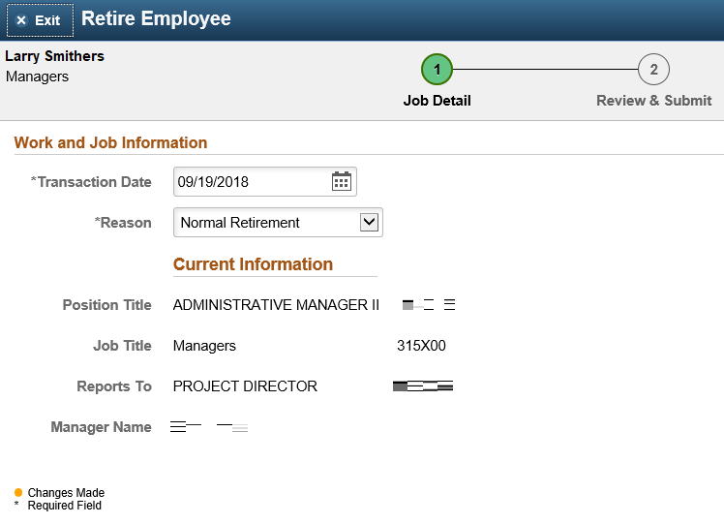
Requesting Retirement for an Employee
A system manager can request retirement for an employee in OneUSG Connect using the retirement form
This is not an intent to retire. When this is requested, the person has already visited Central HR and knows his/her retirement date.
The retirement form replaces a personnel to retire.
Notes:
The Retire Employee transaction replaces the current Terminate Due to Retirement process.
This is not used to express intent to retire. This should only be entered after meeting with Central HR and final decisions about retirement date are made.
Retirement is no longer a type of termination; it has its own category. The reason of retirement cannot be selected for a termination action. You must use the retirement transaction.
This is recording a retirement, not requesting a retirement.

Slide 31
Requesting Retirement for an Employee
This Photo by Unknown Author is licensed under CC BY-SA
Notes:
Demonstration by Instructor – Use Try It! mode
Walkthrough OneSource Training Library Topic: Requesting Retirement for an Employee

Slide 32
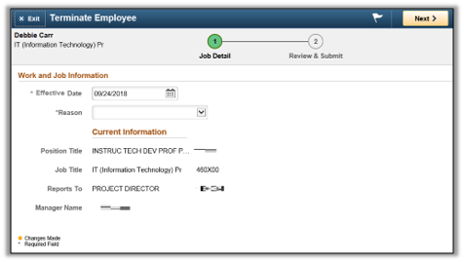
Termination Request
You can request a termination of an employee in OneUSG Connect using the termination form
Enter the termination effective date in the Effective Date field and select one of several reasons for termination
The termination effective date should be the day after the last day the employee worked or the day after last day the employee is in an active HR status, even if the date falls on a weekend, holiday, or during a pay period.
Be aware that retirement is not one of the termination reasons
HR requires the following information in the comments section to support the request:​
Last day worked​ by the employee
Is the employee on leave? If so, what are the dates of the leave?​
If the dept has knowledge that the employee is transferring to another unit, please include the unit to which the employee is transferring.
Notes:
The date you select is important to termination processing as it determines what days the employee will be paid (the next slide has some examples)
The transaction date should be the date you are submitting the request.
On the Terminate Employee transaction, you will select from a list of reasons (excluding retirement, which has its own category)
When requests are received, Central HR will reach out to the departmental requestor for this critical information with an ask for, response by date. ​
Those requested that do not have the accompanying information, will be returned to the department and cannot be processed.​
Effective dates are important as they affect the employee’s permanent record.​ Effective dates will be determined by Central HR based on the information provided in the comments section. Comments should include:
Last day worked
If the employee is on leave and the applicable dates
If the dept has knowledge that the employee is transferring to another unit, please include the unit the employee is transferring to.
In order to ensure an employee does not continue to get paid after a termination has occurred, unit managers must submit a termination through Manager Self-Service.
Already submitted a termination request as part of the Unit Ask?
For terminations already received as a part of the unit asks, including those submitted as part of the bi-weekly review and for those that we will receive as a part of the monthly review, Workforce Administration (WFA) team members will be reaching out to collect additional information for the termination.​

Slide 33
Termination Request Scenarios
Scenario | Last Day Physically Worked | Last Day in Active HR Status | Termination Effective Date | Notes
The employee submits a resignation effective in two weeks. The employee’s last day physically working falls on a Friday, 10/26. | Last day the employee physically worked: 10/26 | Last day in an active HR status: 10/26 | Termination Effective Date: 10/27
The employee submits a resignation effective in one month. The employee’s last day physically working falls on Tuesday, 10/23. However, the employee is approved to take leave 10/24-10/26. | Last day the employee physically worked: 10/23 | Last day in an active HR status: 10/26 | Termination Effective Date: 10/27
The employee submits a resignation effective in two weeks to the supervisor on Tuesday, 10/23. The supervisor tells the employee to finish out the day, but this will be his/her last day working. | Last day the employee physically worked: 10/23 | Last day in an active HR status: 10/23 | Termination Effective Date: 10/24
Notes:
Conditions for termination requests include:
The resignation letter has been submitted.
The Approved Personnel Action/MSS Request has been submitted.
Note that once a termination is sent to Alight, no other activity will be included on the HRID file.
You can contact OneUSG Connect to change a termination date that has already been submitted.
The following 3 slides provide different scenarios for termination requests. You can find the document that lists these scenarios (Termination Requests) in the OneSource Training Library.

Slide 34
Termination Request Scenarios
Scenario | Last Day Physically Worked | Last Day in Active HR Status | Termination Effective Date | Notes
The employee submits a resignation effective in two weeks to the supervisor on Tuesday, 10/23. The supervisor tells the employee he/she is no longer needed and asks the employee to leave immediately. The employee only worked two (2) hours that day. The employee is exempt and is paid monthly. | Last day the employee physically worked: 10/23 | Last day in an active HR status: 10/23 | Termination Effective Date: 10/24 | Note: The supervisor should immediately notify HR of the resignation. HR will terminate the employee in OneUSG Connect with the effective date of 10/24. HR will need to notify payroll immediately so that they can ensure that the employee is only paid for 2 hours on 10/23.
The employee submits a resignation effective immediately to the supervisor on Tuesday, 10/23. The employee’s last day physically working is Wednesday, 10/10. He/she is currently on an unpaid leave of absence. | Last day the employee physically worked: 10/10 | Last day in an active HR status: 10/23 | Termination Effective Date: 10/24 | Note: Please keep in mind that those who are on an unpaid leave of absence will be on benefits billing with Alight.

Slide 35
Termination Request Scenarios
Scenario | Last Day Physically Worked | Last Day in Active HR Status | Termination Effective Date | Notes
The employee submits a resignation to the supervisor effective Tuesday, 1/1. The employee’s last day physically working is Monday, 12/31. The effective date of the termination falls on a holiday. | Last day the employee physically worked: 12/31 | Last day in an active HR status: 12/31 | Termination Effective Date: 1/1
The employee submits a resignation from a temporary position effective Tuesday, 10/23. The employee’s last day physically working is 10/23. The employee has accepted a benefited position with the same institution effective the same day as the resignation from the temporary position. | Last day the employee physically worked (in the temp position): 10/23 | Last day in an active HR status (for the temp position): 10/23 | Position Change Effective Date: 10/24 | Note: The best practice in this particular scenario is to enter this action as a position change instead of a termination. This reduces the number of data changes sent to Alight, therefore minimizing the risk of errors.

Slide 36
Terminations and Transfers
Employees who are transferring within departments at UGA: ​
These are transfers that exist within UGA. ​
Best practices = the employee sharing this information with the intent to resign from his/her current position and to transfer to another unit on campus. ​
Transfer is initiated through UGAJobs when the hiring department submits the Hiring Proposal.​
The department that is vacating the employee should submit the request to terminate the employee, with the coordination of end dates and start dates.​
Notes:
For both scenarios, transfers within UGA and transfers outside of UGA, would involve a resignation from the department that is vacating the employee. ​
Central HR will be working with campus to determine the best ways to indicate this termination and transfer to the employee’s record. ​
In the meantime, if you are aware of a transfer in process (leaving UGA Department X to transfer to UGA Department Y) or an institutional transfer (employee leaving employment from UGA to another USG institution or incoming employee from other USG institution), that information should be included in the comments section of the request. ​
A note about graduate and student positions:
Each person needs his/her own position and hiring proposal​
Hiring proposals need to include the data necessary for OneUSG Connect​
Applies to Graduate/Students/Post Docs​
Be aware of Terminate vs. Terminate Transfer Employee​
Unique Identifier​ applies
For more information on these actions, please visit the SOPs addressing these topics on the OneSource Resource page: https://onesource.uga.edu/resources/oneusg_connect_sops/ ​

Slide 37
Terminations and Transfers
​Transfers outside of UGA- those employees who are transferring to another USG institution: ​
These transfers to other USG institutions involve our partnership with the OneUSG Support team. ​
The HR practitioner submits the transfer on behalf of the institution that is hiring our UGA employee and involves an Employee Transfer Form. ​
The role of Central HR is to monitor any errors with the transfer and provide any support to process the employee’s move from UGA.​
Notes:
For both scenarios, transfers within UGA and transfers outside of UGA, would involve a resignation from the department that is vacating the employee. ​
Central HR will be working with campus to determine the best ways to indicate this termination and transfer to the employee’s record. ​
In the meantime, if you are aware of a transfer in process (leaving UGA Department X to transfer to UGA Department Y) or an institutional transfer (employee leaving employment from UGA to another USG institution or incoming employee from other USG institution), that information should be included in the comments section of the request. ​
A note about graduate and student positions:
Each person needs his/her own position and hiring proposal​
Hiring proposals need to include the data necessary for OneUSG Connect​
Applies to Graduate/Students/Post Docs​
Be aware of Terminate vs. Terminate Transfer Employee​
Unique Identifier​ applies
For more information on these actions, please visit the SOPs addressing these topics on the OneSource Resource page: https://onesource.uga.edu/resources/oneusg_connect_sops/ ​

Slide 38
Requesting Termination of an Employee
This Photo by Unknown Author is licensed under CC BY-SA
Notes:
Demonstration by Instructor – Use Try It! mode
Walkthrough OneSource Training Library Topic: Requesting Termination of an Employee

Slide 39
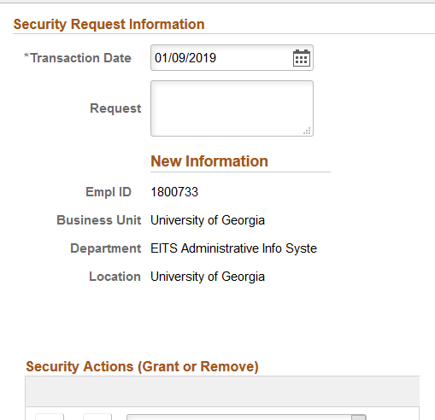
Security Request
Security requests are used by system managers to submit a request for one of their employees
System Managers can request cloning of a role, termination of a role, miscellaneous access, etc
Notes:
If you need to give employees access to transactions that they don’t already have, use the Security Request transaction. You would also use this to request security for new hires.
If you want to give them access identical to another employee’s, that can be specified in the request.
Note to Instructors: No screen shot available at this time

Slide 40
Submitting a Security Request
This Photo by Unknown Author is licensed under CC BY-SA
Notes:
Demonstration by Instructor – Use Try It! mode
Walkthrough OneSource Training Library Topic: Submitting a Security Request

Slide 41
Questions
Notes:
What questions do you have? Can I explain anything for you?

Slide 42
Introducing Commitment Accounting
Manager Self Service for System Managers
Notes:
Commitment Accounting is a module in OneUSG Connect that deals with position funding.
It is where the specifications for funding are entered and also provides a bridge to the UGA Financial Management System.

Slide 43
Commitment Accounting Functions – Position Funding
In Legacy, funding is assigned to a position on the Budget Personnel
In OneUSG Connect, Commitment Accounting is where funding is assigned to a position. Funding sources are used for actual payroll expenses and payroll encumbrances
Notes:
In the previous system, a Budget Personnel was used to assign funding to a position
In OneUSG Connect, funding is assigned using Commitment Accounting.
The funding sources defined for each position will be used to generate the payroll expense entries and payroll encumbrances that will be posted to the budgets and actuals in the UGA Financial Management System.

Slide 44
Commitment Accounting Functions – Payroll Encumbrances
In the previous legacy system, encumbrances were processed in the mainframe Budget system and posted to the mainframe Accounting system. Only salaries are encumbered.
In OneUSG Connect, Commitment Accounting is where encumbrances are projected and an encumbrance journal entry is created. The encumbrance journal entry is then interfaced to the UGA Financial Management System. Salaries, fringes and taxes will be encumbered.
Notes:
In the previous system, only salaries were encumbered. These were processed in the Budget system and posted to the Accounting System.
Within OneUSG Connect, these encumbrances will be projected in Commitment Accounting and encumbrance entries will be created for salaries, fringes and taxes.
These will be interfaced to the appropriate ledgers in the UGA Financial Management System.

Slide 45
Commitment Accounting Functions – Retro Distributions
In the previous legacy system, after-the-fact changes to the distribution of salary, benefit, and tax expenditures were processed by:
Personal Service Journal Vouchers in the mainframe Payroll system
Personnel Activity Report (PAR) adjustments in the ePAR system
In OneUSG Connect, Commitment Accounting is where retroactive changes to the distribution of salary, benefit, and tax expenditures are processed.
Notes:
In the previous system, any changes to the payroll expenses of salary, benefit and tax expenses were processed by Personal Service Journal Vouchers in the Payroll system or Personnel Activity Reports (PAR) adjustments in the EPAR system.
With OneUSG Connect, retroactive changes to salary, benefit or tax distributions will be processed in Commitment Accounting
Personal service adjustments for pay periods processed in OneUSG Connect will be made via retro distribution in Commitment Accounting.

Slide 46
Commitment Accounting Functions – Payroll Actuals
In the previous legacy system, the mainframe Payroll system assigned the salary, benefit, and tax expenses to the appropriate account number and created a payroll journal entry as a part of payroll processing. The payroll journal entry is then posted in the mainframe Accounting system.
In OneUSG Connect, Commitment Accounting attaches funding to payroll expenses (salary, benefit and tax) after payroll processing is complete. A payroll journal and encumbrance liquidation journal are created and interfaced to the UGA Financial Management System.
Notes:
In the previous Payroll system, salary, benefit and tax expenses were assigned to the appropriate account number and a payroll journal entry was created as part of processing. This journal was posted to the Accounting system.
With OneUSG Connect, Commitment Accounting attaches the salary, benefit and tax expenses after payroll processing is complete and sends it to the UGA Financial Management System via an interface

Slide 47
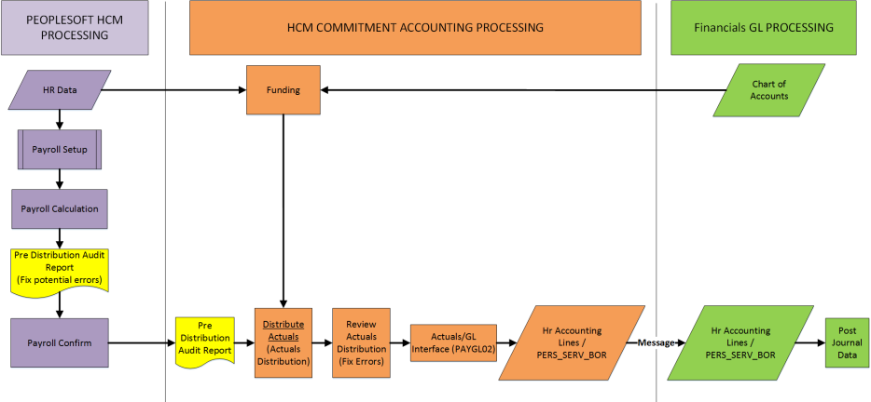
Commitment Accounting Process Flow
2
Integration Broker + BUD003
1
Review Invalid Funding Report DAILY
3
4
Run Pre-Dist Audit Report During Payroll Processing
Retro
5
Notes:
This diagram illustrates how Commitment Accounting Processing works with HCM Processing. It also shows how information is sent to Financials to be recorded in the General Ledger. The items that are called out are the responsibility of UGA. The remainder is processing done at USG’s Shared Services Center (SSC).
UGA Central Accounting maintains the Chart of Accounts that is used as the basis for the Combination Codes (funding) that are attached to each position
HR and Department Managers work together to maintain information on new hires and position changes. They attach people to positions which sets up the source of funding for each individual. (CLICK)
The Invalid Funding Report indicates errors in funding that will not process correctly in payroll. This should be run and monitored daily to allow time to fix errors before payroll processing begins. (CLICK)
Central Commitment Accounting will run the Pre-Distribution Audit report after the SSC has calculated the payroll. This will show all errors (not just position funding errors) that need to be corrected to process correctly. It is run again by the SSC as part of the Payroll processing. (CLICK)
After Central Commitment Accounting reviews actuals, any corrections to funding will need to be made as part of retro processing.
We will talk about the things that happen in Commitment Accounting during this course.

Slide 48
The Magic Starts When…
Payroll Confirms
Notes:
Other than the Position funding entry, (CLICK) the magic of commitment accounting happens with payroll confirmation.

Slide 49
What We See…
Payroll Confirms
A Miracle Occurs
Accounting Lines go to General Ledger
Notes:
Everything happens behind the scenes.
Payroll confirms – something happens “automagically” – and then….
Accounting lines for payroll are added to the general ledger.
This means that for funding changes to apply to a particular pay period, the funding change request would have to make it through all approvals (including Central Office) by the pay period end date. For example, if the pay period end date is 11/03/2018 funding changes for that pay period would have to be through final approval by 11/03/2018.

Slide 50
The Miracle Explained
Notes:
As you can see in the diagram, this is a very complicated process. The diagram outlines all the difference pieces of this process and how they are interconnected.
[Pause so the attendees can look at the diagram.]
[If there are any questions about the processes, you can review the following information with the attendees:]
Bulldog Red box and lines: Employees and managers enter personal data, job-related transactions and position information into the OneUSG Connect System. That information is used in the Commitment Accounting Encumbrance and Payroll processes. Information is also sent to the UGA Data Warehouse for use in reporting.
2nd line: When payroll confirms, processes are run to send the payroll information back to the UGA Financial Management System. The Commitment Accounting Actuals Distribution sends information to the UGA Financial Management System Commitment Control KK Journal and is also used in the Commitment Accounting Actuals GL Interface that loads general ledger entries from payroll into the UGA Financial Management System General Ledger journals. Information from both of those systems are exchanged with the UGA Budget Management System (green lines)
Bottom line: In order to run the encumbrance processes which we will talk about in this course, the Encumbrance Definition tables are configured and updated by SSC. When the Encumbrance processes are run, they combine the information from the Encumbrance Definition table and the HR Job and Position Data and create the Commitment Accounting Encumbrance Interface. That interface creates an encumbrance journal which is processed in the UGA Financial Management System and updates the Commitment Control Ledgers. Information from that journal is also sent to the UGA Budget Management System.
Top Line: Information is sent from the UGA Financial Management System to populate the Commitment Accounting ChartFields and Combo Codes tables. That Information is used in the Commitment Accounting Department Budget Table that combines the position and combination code information. Information from the Department Budget Table goes into the Data Warehouse for reporting and is also shared with the UGA Budget Management System.

Slide 51
Introducing Combo Codes
Manager Self Service for System Managers
Notes:
Now that you have the big picture, lets take a look at the individual elements that you will work with for your department or unit.

Slide 52
Combination Codes
Used by OneUSG Connect Commitment Accounting to assign the funding for a position.
ChartFields used in these combo codes include:
Fund
Program
Class
Department ID
Project ID (if used)
PC Business Unit
Activity ID
Chartfield 1 (if used)
Operating Unit (if used)
The Budget Reference ChartField is assigned by the system based on the accounting period of the payroll entry
The Account ChartField is determined by the paygroup and earnings code associated with the position
Notes:
The Combination Codes are the critical piece that tie the payroll expenditures to the GL entries. This is the HCM equivalent of a SpeedType
Combination codes are used (like the UGA Financial System’s SpeedTypes) to provide a shortcut entry for the funding source.
A Combination Code is made up of a set of ChartFields which will be charged for the funding of each position. The ChartFields used must include Fund, Program, Class, Department ID, Budget Reference (which is automatically entered based on the accounting period of the payroll entry) and the Account ChartField (which will be automatically entered based on the paygroup and earnings code that defines the position).
If the funding is in association with a project, a Project ID, PC Business Unit and Activity ID are required.
Chartfield 1 and the Operating Unit may be used as needed.
A resource page is available for Combo codes. Onesource.uga.edu > Resources > C > Combo Codes

Slide 53
What are Suspense Combo Codes
If no active combo code exists to fund a position, the expenditure (salary, benefits, and taxes) will be charged to the Suspense Combo Code
Each intermediate unit will have one Suspense Combo Code and will be responsible for monitoring and correcting the payroll transactions that post to the suspense combo code.
See the Combination Codes Resource page on the OneSource website for list of intermediate unit suspense codes
onesource.uga.edu > Resources > C > Combo Codes
Notes:
If there is not an active code to fund a position, payroll will charge the Suspense Code set up for that unit.
Each unit will need to monitor the Invalid Funding Report to avoid charges to the Suspense code which will require adjusting entries to correct to the right ChartFields.
Funds do not have to be available in the Suspense Combo Code for payroll to post to it.
Intermediate units = one suspense code for each major unit

Slide 54
More About Combo Codes
Only one Combo Code is created for each unique financial chartstring used for payroll expenditures
14 characters in length (17 characters for suspense combo codes)
Naming Convention – start with 18
Combo Codes: 18+ 8 digit finance department number + a four digit sequential number generated by the system
Example: 1819210BMB1010
Suspense Combo Codes: 18+ 8 digit finance department number + a four digit sequential number generated by the system + “SUS”
Example: 1819210BMB1010SUS
Onesource.uga.edu
Resources
C > Combo Codes
Notes:
Each unique chartstring will have one Combo Code that will be used for payroll.
Each code contains 14 characters and uses the naming convention shown here.
Combo Codes and Suspense Combo Codes start with 18 which is the UGA “company” number in the USG systems

Slide 55
How Combo Codes are Created
Created in the UGA Financial Management System by Central Commitment Accounting and messaged to OneUSG Connect Commitment Accounting
Departments can make requests to:
Create a new combo code
Inactivate a combo code
Reactivate an inactive combo code
Make a change to the combo code description
ChartFields associated to Combo Codes cannot be changed
Notes:
Departments must use a form from the OneSource Service Desk (Team Dynamix) to request a new combo code to be added. ​
The same form is also used to modify or reactivate/inactivate the code. ​
If you have a large number of Combo Codes that need to be created at the same time, there is an option to submit via a spreadsheet.​
Changes can only be made to the Description (name) of the Combo Code, not the ChartFields.

Slide 56
Finding a Combo Code
Requesting/Updating a Combo Code
This Photo by Unknown Author is licensed under CC BY-SA
Notes:
Demonstration by Instructor – Use Try It! mode
Walkthrough OneSource Training Library Topics:
Finding a Combo Code
Requesting/Updating a Combo Code

Slide 57
Understanding Position Funding
Manager Self Service for System Managers
Notes:
Once the Combination Codes are created they are tied to the positions to show the funding source.

Slide 58
What Is Position Funding?
Positions are created from jobs
Positions are funded
People are hired into the positions and associated to the funding distribution (combo code) for that position and HR department
Notes:
Each position is made up of one or more job-related codes.
A combination code is added to the position definition to set up the ChartFields that will be charged and sent to the UGA Financial System and the UGA Budget Management System when used in payroll.
People are hired into the positions and the Combo Codes are used in payroll processing.

Slide 59
Commitment Accounting Department Budget Table
The department budget table, within Commitment Accounting, is where funding is assigned to positions. This is updated by Central Commitment Accounting.
Funding may be assigned to a single combo code or multiple combo codes
If a position is funded by multiple combo codes, the distribution is by percentage
Funding must total 100% for each position
The default is for fringe and taxes to follow earnings (same combo code as earnings)
If fringe and/or taxes need to be charged to a different combo code, they can be redirected to a different combo code in the department budget table
Notes:
Information on positions is entered on the Department Budget Table (report being created to show the funding history for a position from the DBT. A new topic will be available when this is complete). This page gives view-only access to see a complete picture of how a position is funded. There may be multiple effective dated rows that determine a complete picture of the funding.
Commitment Accounting allows you to assign funding to more than one combo code and designate the percentage to apply to each as long as the total percentage totals to 100%. Fringe and taxes will be charged to the same code unless you enter them separately.
Funding setup and changes allow you to charge the fringe and taxes to different combo codes if needed.
Correct setup avoids adjusting entries after payroll is run.

Slide 60
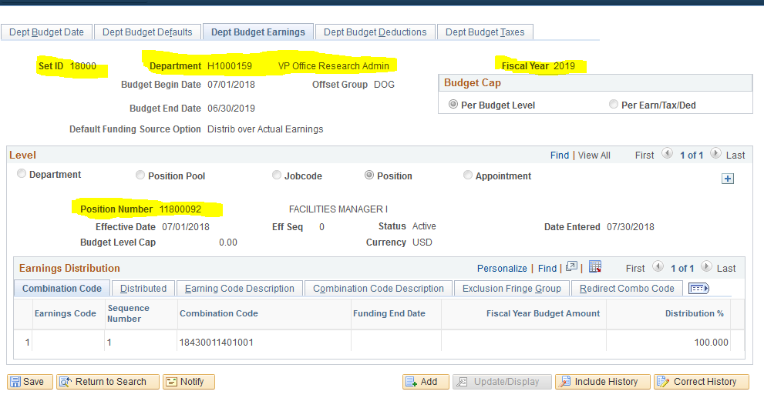
Positions in Commitment Accounting Department Budget Table
Each position belongs to a single HR Department
The unique fields for funding are the HR Department ID, the Position Number, the SetID (18000 for UGA), and the Fiscal Year
Positions that move to a new HR department require funding to be set up for the new HR department
Notes:
This is a screenshot of the Earnings tab on the Department Budget Table. While you will not be able to view this screen, there are 2 queries at this time (Funding for Position and Employee and Funding for Posn and Emp by Chartfield) which will give you the detailed funding history found in the Department Budget table.
Unique fields for funding are the Department ID, Position Number, SetID (18000) and the Fiscal Year.
Each position can only belong to one HR Department. If that position moves to another department, funding must be set up for the new department.
HR departments are not the same as Finance Departments.
Finance departments are based on budgets.
HR Departments are built based on “reports-to” structures.

Slide 61
Monitoring Funding Errors
It is the responsibility of the departments to run the Invalid Funding Report and clear up any errors found there
The report shows the errors that will be encountered in payroll.
Departments will need to correct errors before the payroll run. All funding changes need to be entered, approved and processed by one day prior to the ‘Time Detail and Adjustments to SSC’ payroll calendar date for that particular payroll.
If errors are not corrected, payroll expenditures will post to the suspense combination code
Notes:
Departments need to be sure that the funding for their department is set up correctly to avoid having to correct a lot of errors when payroll runs.
The Invalid Funding Report can help identify the problems that might occur.
This report is run by the departments and is now available when the system goes live. Departments can run each day for the payroll in process and may be run up until the time when the paysheets are created.

Slide 62
Running the Invalid Funding Report
This Photo by Unknown Author is licensed under CC BY-SA
Notes:
Demonstration by Instructor – in Try It! mode
Walkthrough OneSource Training Library Topic: Running the Invalid Funding Report

Slide 63
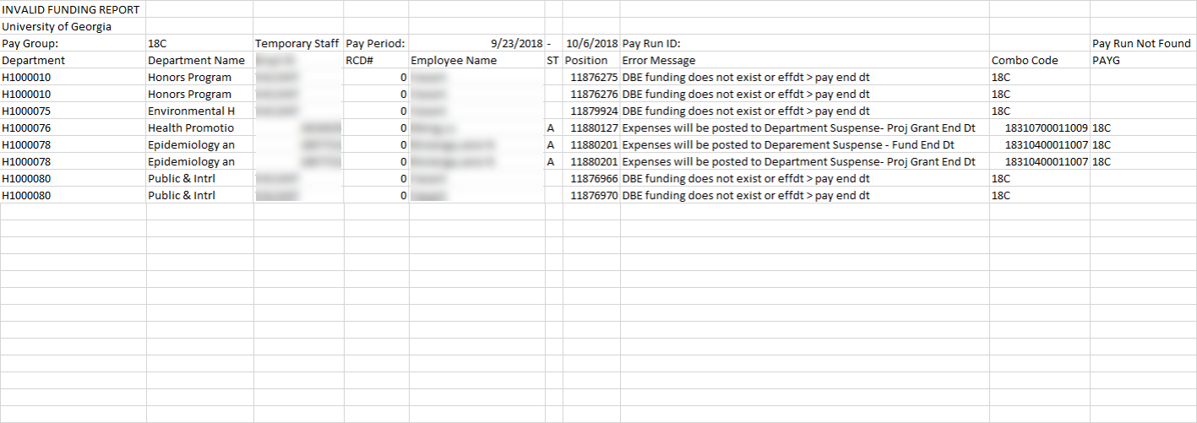
Invalid Funding Report Results
Most common error messages
DBE funding does not exist or effdt > pay end dt
Expenses will be posted to Department Suspense- Proj Grant End Dt
Expenses will be posted to Department Suspense - Fund End Dt
Combo code not active in valid combo table
Notes:
Here is sample output from the Invalid Funding Report showing some of the most common errors.
This report should be distributed to you in an Excel format which will allow you to filter the data in the report.
The errors shown here are encountered most often and will be discussed more on the following slides

Slide 64
DBE Funding Does Not Exist or effdt > pay end dt
Message indicates that there is no funding for that position or the start date of the funding starts after the pay period ends
Make sure there is funding for the position
Check the Funding for the position to compare effective date of position funding with the pay period dates. Correct any errors.
Notes:
This error indicates that there is no funding for the position or that the effective date of the funding is after the pay end date
You would need to be sure that funding exists
Then you would need to check on the funding to look at the effective date and how it coincides with the pay period.
It is up to the units to correct any errors.

Slide 65
Expenses will be Posted to Department Suspense
Project Grant End Date
Determine if the project end date can be extended
If the grant funding ends during the pay period, funding should be added to cover the remainder of the pay period and pay periods going forward
Fund End Date
Check for the end date of the funding for the project
This error could mean that changes to the funding end date made in the UGA Financial Management System did not flow through to update the funding end date in OneUSG Connect.
Contact oneusgsupport@uga.edu to create a ticket for Commitment Accounting in this situation. Include: pay period, position number, and HR department
Notes:
The End Date for projects and grants go from the UGA Financial Management System to OneUSG Connect via an interface.
There may be instances where changes to the end date do not interface correctly and do not update OneUSG Connect as they should.
If the error message indicates Project Grant End Date
Verify the end date of the funding with SPA post-award.
Verify any extensions
If the funding ends in the middle of the pay period, you will need to add funding to cover the remainder and any future periods where payments will be made
If the error message indicates Fund End Date, you will need to:
Check the funding end date
Work with Central Commitment Accounting to resolve the error via oneusgsupport@uga.edu.
For more on how to correct payroll entries charged to suspense accounts, see the topic “Correcting Payroll Entries Charged to Suspense Accounts” in the Training Library under MSS for System Managers.

Slide 66
Combo Code Not Active in Valid Combo Table
The combination code being used for funding is inactive
To correct this error, you should:
Review funding to verify the dates
Determine if a new combo code is needed or whether the old one should be reactivated
Use the Team Dynamix form to request a new code, reactivate a code (can access via the Training Library under the Correcting Invalid Funding Reports topic)
Notes:
Another common error you might see is Combo Code Not Active in Valid Combo Table
This means that the combination code attached to the position has been inactivated
To correct the error, review funding dates, determine if you need a new combo code or if you should reactivate the old one, then use the form to do so.

Slide 67
Changing Funding
All positions are funded in the same manner.
Departments are responsible for determining which combo codes should fund a position and the percentage distribution to each combo code. The mechanics for setting up the funding in OneUSG Connect is the same for all positions.
Special groups, like Federal work study students, are in a special paygroup for payroll processing.
Notes:
All positions are funded the same way through the departments who determine how to fund.
Special groups, like Federal work student students, are in a special group for payroll processing, but their positions are not funded differently
There are two pages in the system to interact with funding. The Submit Position Funding Request page is for the initial submission of changes. The Funding Distribution Change page is to review the status of the change requests. The Approvers will also use the Funding Distribution Change page for more detail when approving.
When you enter information on the Funding page, you are entering a new effective-dated row beginning with the first date the change should be calculated (past, present or future). If two are entered on the same day, the transactions will be given a sequence number and the system will look at the information on the highest sequenced row to base calculations.

Slide 68
Approving Funding Changes
Previously in WebDFS, the approvals ran based off of department/account number where any departments providing funding were part of the “approval queue.”
In OneUSG Connect, once a department enters the funding information (through MSS), the workflow only flows through approvers for that HR Department.
If the position is funded from a department outside of the HR Department which owns the position, the manager from the outside department should be added as an ad hoc approver.
The second department will be able to see the use of their combo codes and funding via a query that is being developed.
Notes:
Previously, all approvers are based on department/account numbers in funding.
Since positions are owned by a single HR department in OneUSG Connect, only the approver for the owning department is included in the approval queue. The initiator will need to add in other approvers as ad hoc approvers
Ad hoc approvers can be added when they are not a part of the regular approval process flow. An example might be a department head that doesn’t need to see every transactions, but need to see certain transactions.
Ad hoc approvers can be added by anyone with access to the transaction (initiators and approvers). When selecting an approver, only those with the role of manager or a special ad hoc approver role will appear in the list. If someone is missing from the list, submit a security request to get that role commissioned
A query is being developed to allow departments to see the use of their combo codes in funding. This would allow departments to see when charges appear for that combo code.
Reminder: For funding changes to apply to a particular pay period, the funding change request would have to make it through all approvals (including Central Office) one day prior to the HR/Payroll Deadline date indicated on the Pay Calendar.

Slide 69
Submitting a Change to Funding for an Existing Position
This Photo by Unknown Author is licensed under CC BY-SA
Notes:
Demonstration by Instructor – in Try It! mode
Walkthrough OneSource Training Library Topic: Submitting a Change to Funding for an Existing Position

Slide 70
Understanding Encumbrance Projections
Manager Self Service for System Managers

Slide 71
Key Payroll Processes
Actuals GL Interface (PAYGL02) creates
Payroll expense accounting entries (ACTUALS Ledger)
Encumbrance projection entries (Budget Ledgers)
Encumbrance liquidation entries (Budget Ledgers)
Uses HCM information (compensation from Job Data, Pay Groups and Earnings Codes, Position Funding, etc.) and BOR Encumbrance Controls
The Encumbrance process is run by the Shared Services Center
Encumbrances processed once a month at the end of the month
Encumbrance liquidations processed after each payroll
Notes:
When the GL interface is run it creates the things you see here.
The payroll expense accounting entries are sent to the Actuals Ledger.
Encumbrance projections and liquidations are sent to the Budget Ledgers in the Finance system. From there the budget system will be updated.
Liquidations only include liquidations for payments. If someone is removed from payroll at the beginning of the month, the encumbrance would change at the end of the month when the new process is run.
Processes are run by the Shared Service Center and sent to the UGA Financial Management System.
The first encumbrance processes in OneUSG Connect will be run January 31, 2019.

Slide 72
What is encumbered?
Filled positions that belong to a paygroup that is encumbered:
18A – Salaried
18E – Exempt Hourly
18F – Academic Year Faculty
18G – Graduate Assistants
18H – Staff – Hourly
18J – 10 Month Non-Exempt
18L – Temporary Salaried
18P – Part-Time Faculty
18S – Summer Faculty
18X – 10 Month Non-Faculty Exempt
18Y – 12 Month Faculty
Notes:
Pay, fringes and taxes are encumbered for the employees in the paygroups listed on the slide

Slide 73
Salary Encumbrance Calculation
Based on annual compensation rate in job data
Encumbrance process creates encumbrances based upon the remaining open pay periods in the fiscal year
Encumbrances are created from the start date to the end of the fiscal year
If the funding end date (Grants) ends before the end of the fiscal year, encumbrances will only be created through the funding end date.
Notes:
Here you see how the salary encumbrance is calculated based on the annual compensation rate entered for the employee.
The compensation rate used is the annual compensation rate from the job data pages
The encumbrance calculation is based on the remaining open periods in the year.
Encumbrances are created from the start date to the end of the fiscal year or until the funding ends.

Slide 74
Fringe Encumbrances
Fringe encumbrance elements
Health
Life
Health Savings Account
Retirement
Fringe Encumbrance Calculation
Fringe encumbrances are calculated based on the last paycheck the employee has received , unless paycheck was for Bi-Weekly #3 (uses Bi-Weekly #2)
Most fringes are based on a flat amount.
Notes:
Fringes are calculated on the elements shown:
Health
Life
Health Savings Account
Retirement
Encumbrance calculations are based on the last paycheck the employee received or Bi-Weekly #2, in cases where there is a Bi-Weekly #3
Most fringes are based on a flat amount

Slide 75
Tax Encumbrances
Tax Encumbrance Calculation
Calculated as a percentage of gross
Calculates based on taxable gross, not paycheck gross
Notes:
Tax encumbrance calculation are based on taxable gross and calculated a percentage.

Slide 76
Understanding Retro Distributions
Manager Self Service for System Managers
Notes:
Corrections made after payroll is complete necessitates retro distributions to correct the entries that have already been posted.

Slide 77
Retro Distribution Basics
Retro Distributions reallocate payroll costs, incorporating and applying position funding changes made after the payroll accounting entries were created and/or distributed to the GL.
Budget Retros
Direct Retros
Corrections processed in the Legacy System (July – December 2018) will need to be entered as a General Ledger Journal in the UGA Financial Management System.
Use the Retro Distribution methods for adjustments,processed In OneUSG Connect after January 1, 2019.
Notes:
Retro Distributions refer to corrections made to entries after payroll is confirmed and/or sent to GL
There are two types of retro distributions (budget and direct) which are defined on following slides.
Retro processing is done on an off-cycle (not in an actual pay cycle) calendar.
Note: A general ledger journal entry, in the UGA Financial Management System, will be required to process payroll adjustments for pay periods processed in the legacy payroll system (July – December 2018). Personal service adjustments for pay periods processed in OneUSG Connect will be made via retro distribution in Commitment Accounting.

Slide 78
Budget Retro Changes
Budget Retro - changes to all prior period payroll accounting entries on or after the effective date of the change, triggered by a change in funding
Reclass JE
Month 1
Month 2
Month 3
Effective Date
Notes:
This is triggered by changing the Funding on Existing Positions.
This will make the retro (past) entries and set the funding to the correct combo code in future payroll runs.
For example, if you realize in Oct. that a person on a govt combo code should have been paid on a grant, you can set up a row on the funding page.
The effective date should be the date the funding should have started from the new source.
This will make correcting entries for past payrolls and set things up correctly for future processing.

Slide 79
Direct Retro
Direct Retro - one-time changes to payroll accounting entries in a specified date range. Departments will request changes and Central Commitment Accounting will enter.
Reclass JE
Month 1
Month 2
Month 3
Effective Date
Notes:
Direct Retro entries are changes that need to be made on a one-time basis for a specific payroll and do not affect past or future payrolls.
These changes will be made by Central Commitment Accounting.
A form is being created which will be found on the OneSource Service Center web page to request that these corrections can be made.
For now, submit a service desk ticket to request a Direct Retro at onesource@uga.edu

Slide 80
Combining Budget and Direct Retro Entries
Budget & Direct Retros – combination of changes to payroll accounting entries in a specified date range
Reclass JE
Reclass JE
Month 1
Month 2
Month 3
Effective Date
Notes:
Some errors may require that you correct using both types of correcting entries.
Here’s an example: It’s currently October and let’s say it was determined that funding for a position needed to be changed to go back to July 1st.
The month of July should have been charged to a state combo code and the months of August forward should be charged to a grant combo code.
You would request a direct retro for the month of July only.
Then you would go through the position funding change page and change the funding with an effective date of 8/1/2018 and use the grant combo code.
This would trigger a budget retro distribution to correct August and September and then the funding for October and future pay periods would be correct (grant combo code).

Slide 81
Questions
Notes:
What questions do you have? Can I explain anything for you?

Slide 82
Introducing MSS Workflow
Manager Self Service for System Managers
Notes:
In this section, we will discuss the basics of MSS Workflow

Slide 83
Ad Hoc Review and Approve
ESS Transactions go straight to HR
-name change, degree
Initiator – System Mgr (BOR role)
1
2
3
4
5
-Only for Initiator, one up/down and lateral
-At Save
-Uses Approval Tiles
Must be a system manager or ad hoc app role, in or out of the department
Approvers can assign one prior to approval
Initiator can after they submit
Absence and time flow DOES NOT FOLLOW , goes straight to Reports to
Notes:
Ad hoc reviewers can be assigned by initiators or approvers (one up/down and lateral). If the transaction should be sent next to a person not in the approval workflow, an ad hoc approver can be inserted. Ad hoc approvers are selected from a list that includes System Managers and employees who have been assigned an Ad Hoc approver role.
Employee Self Service transactions for personal information changes go directly to HR
Other requests go to the System Manager or ad hoc approver for the employee’s department

Slide 84
Delegation
Delegation is set up according to Reports-To information, not for system managers who have access to an entire department
Delegation is only set up for Reports-To delegation and approvals
As a System Manager, if you want to delegate one of your transactions listed in table, you must submit a security request so the person can do specific tasks
Ex: If a System Manager goes on vacation, he/she can do a security request to allow access to another employee for the same dates.
Notes:
Delegation uses Reports-To Approvers.
It is not for System Managers who have the ability to view an entire department
System Managers who want to delegate a transaction must submit a security request to set up their delegate

Slide 85
Summary
Manager Self Service for System Managers
Notes:
Lets look at a recap and some final information.

Slide 86
Summary
During this training, you have learned:
How to submit Manager Self Service requests on behalf of your reports-to employees
How to recognize how Commitment Accounting is used to tie information that is processed in OneUSG Connect to the appropriate entries in the UGA Financial Management System and the UGA Budget Management System
How to recognize combination (combo) codes and how they are tied to the positions employees fill
How to review the Invalid Funding Report and understand ways to resolve the errors
How to request changes to the funding for your department’s positions
To recognize the encumbrance entries and how they are calculated and sent to the UGA Financial Management System
To understand how to initiate retro distributions to correct errors
Notes:
Go over the points on the slides
Ask for questions on anything that needs clarification

Slide 87
Getting Help
Issue/Problem | Contact
ArchPass Duo and VPN support MyID password resets | EITS HelpDesk 706-542-3106 helpdesk@uga.edu
Using the OneUSG Connect System | 706-542-0202 oneusgsupport@uga.edu
UGA Financial Management System UGA Budget Management System | 706-542-0202 onesource@uga.edu
Email and phone assistance available by phone M-F, 8am-5pm or 24/7 in the OneSource Training Library
Note different email addresses for help
Notes:
If you need help, here’s where you can get it.

Slide 88
Learning Opportunities
Additional Classes
Manager Self Service for Supervisors
Time & Absence Approvers
Self-Service courses
Approving MSS Transactions
Reporting and Queries
Class formats
Self Service
Recorded
Interactive Webinar
In Person
Notes:
This lists some additional classes that you may be interested in.

Slide 89
Learning Opportunities
onesource.uga.edu
OneSource Resources Web Pages
By topic
Recorded sessions and forums
Documentation
OneSource Training Library
Self Service
Recorded
Interactive Webinar
In Person
Notes:
You can find courses on the OneSource training web page. You’ll see how to register for classes or webinars.
The training library is available 24/7 so you can view topics and see how things work in the new system.

Slide 90
Learning Opportunities: Training Library
https://training.onesource.uga.edu
Notes:
Provides simulated walkthroughs
Gives “Access” to the system before you get access

Slide 91
Different Modes in the OneSource Training Library
View a video of a topic The video changes frames every 5 seconds. You can pause the player if you need more time on a slide. You can press Enter if you want to advance more quickly. | Simulate actions and practice In the soon-to-be-released system, you can follow the steps to practice completing a specific task, entering values into the simulated system if necessary. | Coach you through the steps You can use this mode to open a topic in a small window while completing a task. You can keep this window in the forefront while working on your designated UGA page. | Print the Job Aid of a topic You can save, download, and print the Job Aid of a topic as a reference.
Notes:
Select a topic on the left, then choose to See It, Try It, or Print It, depending upon how you want to interact with the test system.

Slide 92
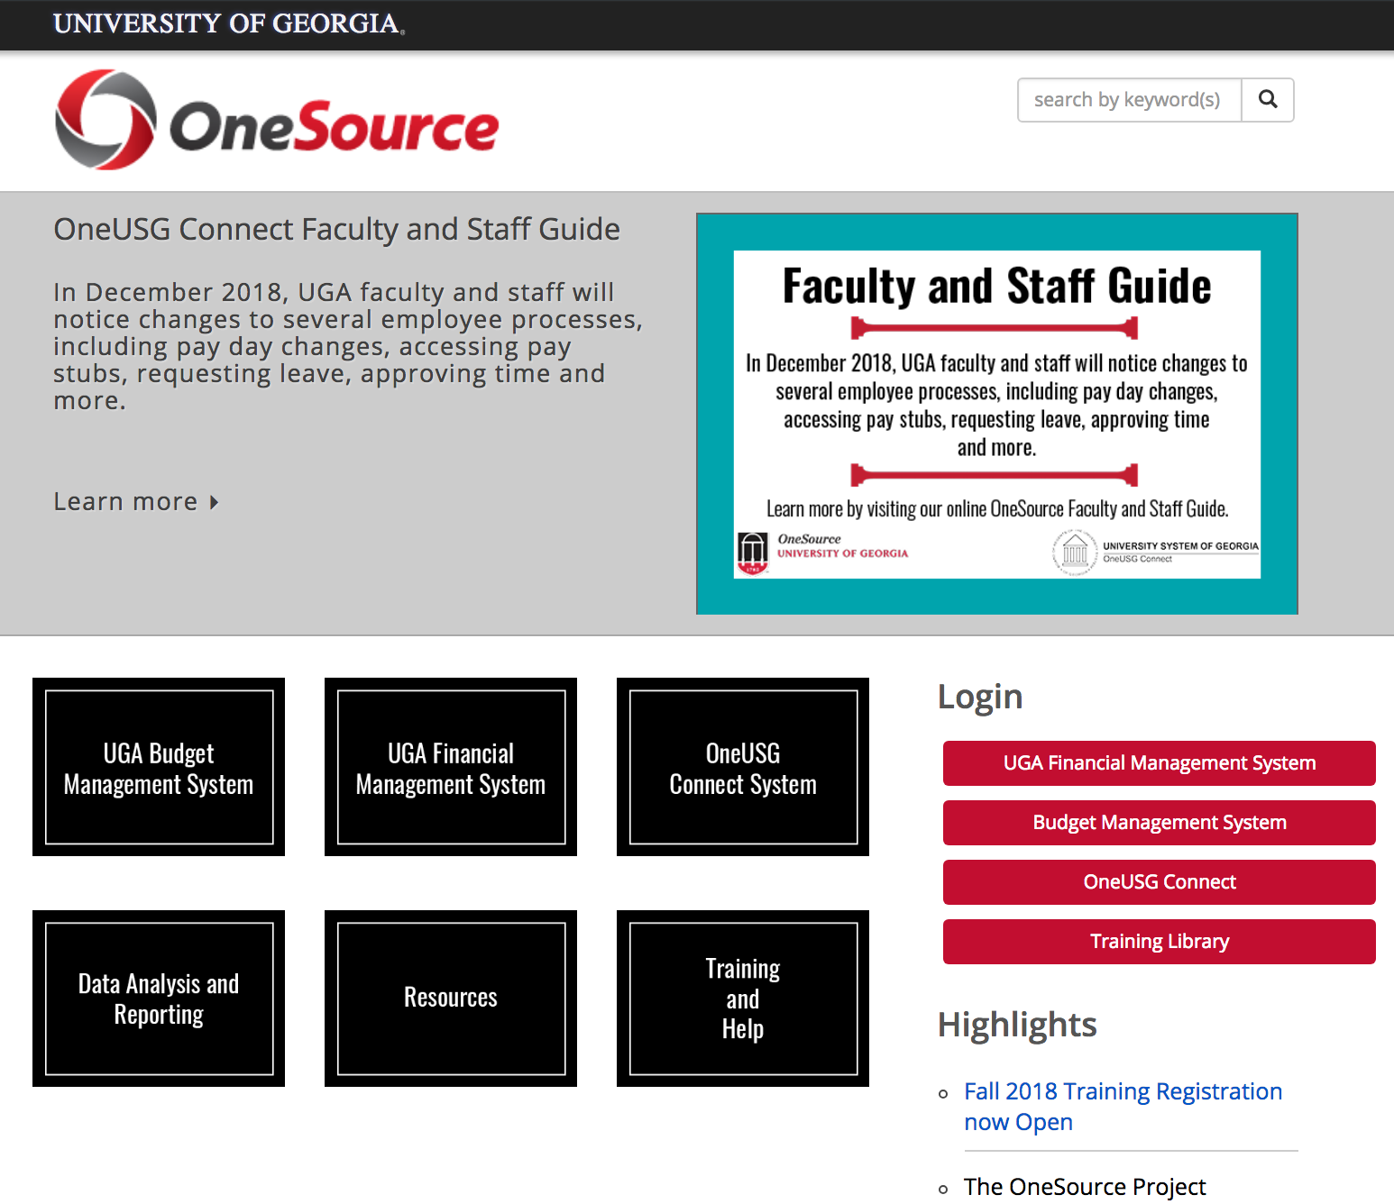
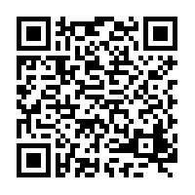
Attendance and Evaluation:
http://bit.ly/SYS-MGR
onesource.uga.edu
oneusgsupport@uga.edu
706-542-0202
Notes:
The link to mark your attendance today is on the screen. You will also have the option to complete a course evaluation. We appreciate your feedback and we will use it to improve the course.
Encourage people to send department-specific or situation-specific questions to OneSource for additional research.

