Slide 1
Recording Intra-University Charges
UGA Financials Management System
General Ledger
Notes:
Updated 11/04/2020

Slide 2
Intra-University Charges
Intra-University Charges are created when one University Department buys and sells goods to another University Department.
These are entered like other general ledger journals with the exception of the information provided in this document.

Slide 3
Intra-University Process
Buying Dept(s)
Request goods or services
Selling Dept
Provide goods or services
Document final cost
Create journal (online or in spreadsheet)

Slide 4
Intra-University Revenue Entry
Entering the Revenue (credit) side of the entry
Use Class Code 41500 for Departmental Sales & Service funds (14xxx)
Use the appropriate Class Code associated with the fund for all other funds
Use revenue Account Code 471100 for all funds
Refer to the Nature of Account Rules document (https://onesource.uga.edu/_resources/files/documents/nature_account_rules.pdf)

Slide 5
Intra-University Debit Entry
The Expense (debit) side of the entry should follow these guidelines:
Account Code should classify the type of goods or service being purchased.
Example: 714104 – copier supplies; 727110 – registration fees; 727111 – bundled conference expenses
Refer to the Chart of Account Reference Document (https://onesource.uga.edu/resources/chart_of_accounts/)

Slide 6
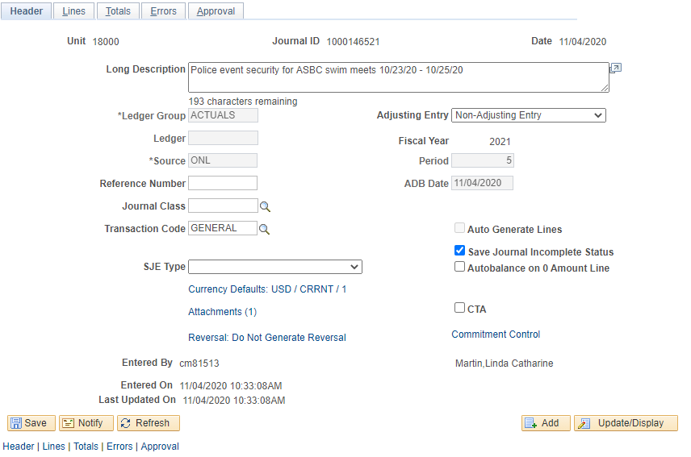
Departmental Sales and Service Example
Enter details about the services rendered in the Long Description field.
Attachments: Include a copy of the invoice and other documentation, if necessary

Slide 7
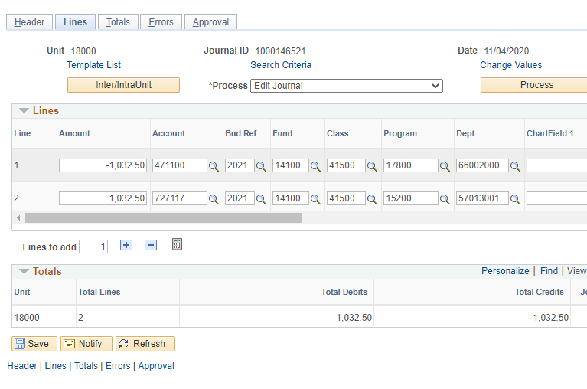
Departmental Sales and Service Lines

Slide 8
Departmental Sales and Service Lines
The Reference field should include the invoice number
The Journal Line Description should describe the services
Unit providing services (abbreviated)
Services provided
Month provided

Slide 9
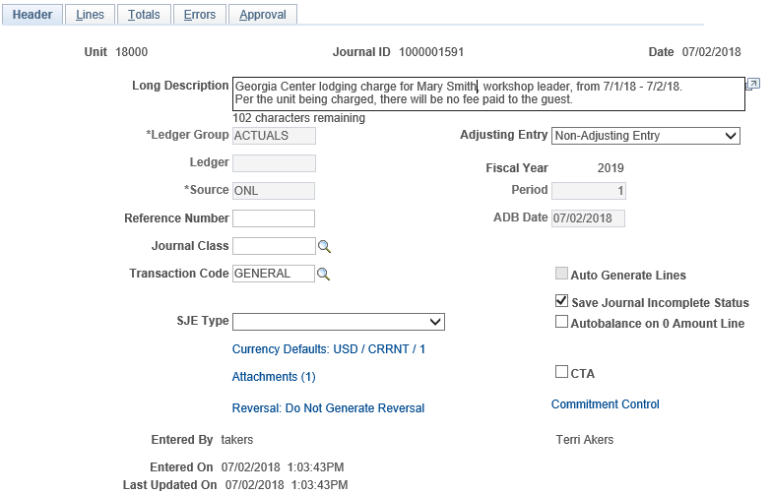
Auxiliary Example
Enter details about the services rendered in the Long Description field.
Attachments: Include a copy of the invoice and other documentation, if necessary

Slide 10
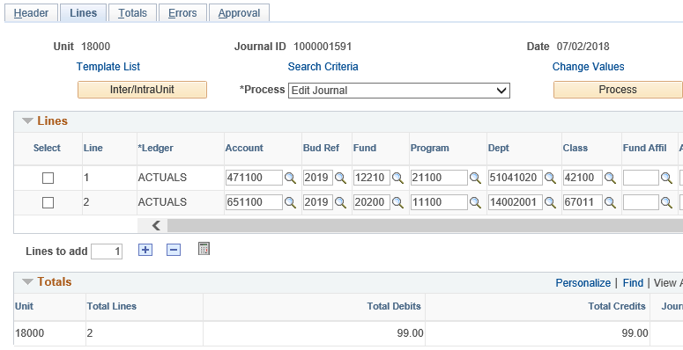
Auxiliary Services Lines

Slide 11
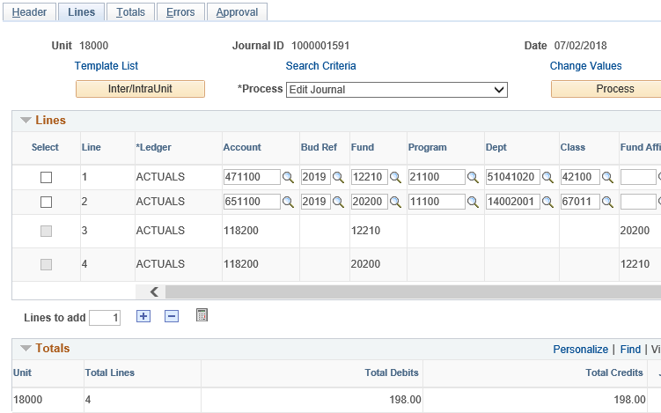
Auxiliary Services – After Edit Journal
The system automatically adds new rows after the Editing Journal process is complete in order to balance cash when transactions are crossing Funds.

Slide 12
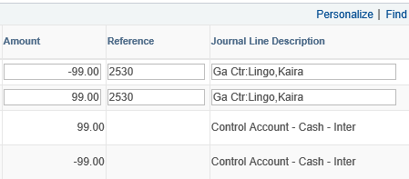
Auxiliary Services Lines
System inserts description of added lines
The Reference field should include the invoice number
The Journal Line Description should describe the services
Unit providing services (abbreviated)
Services provided
Month provided

Slide 13
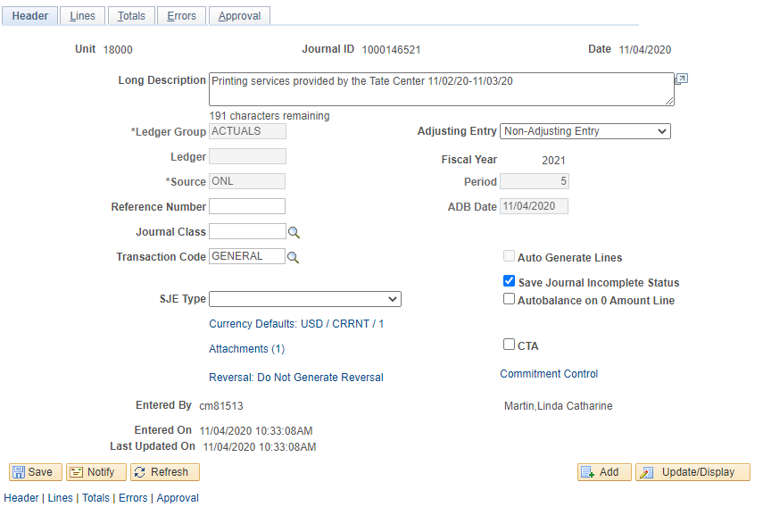
Other Sales and Service Example
Enter details about the services rendered in the Long Description field.
Attachments: Include a copy of the invoice and other documentation, if necessary

Slide 14
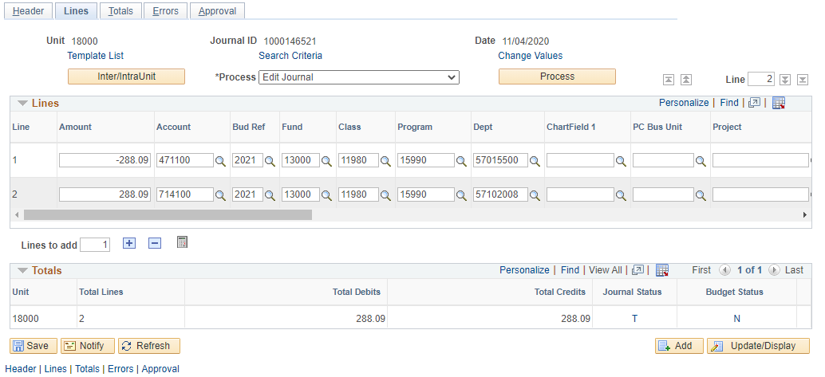
Other Sales and Services ChartFields

Slide 15
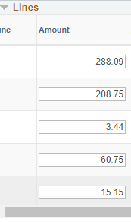
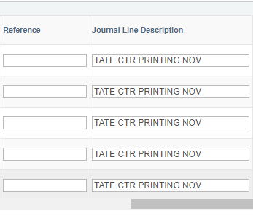
Other Sales and Services Line Description
The Reference field should include the invoice number
The Journal Line Description should describe the services
Unit providing services (abbreviated)
Services provided
Month provided

Slide 16
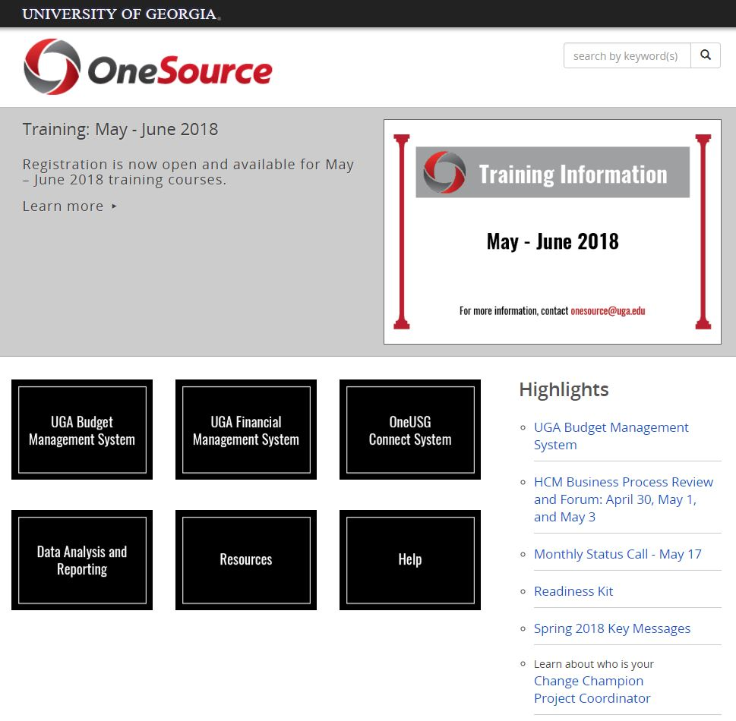
Project Information
onesource.uga.edu
OneSource Service Desk
onesource@uga.edu
706-542-0202

